Slide 1
Chapter 8 Classes and Objects: A Deeper Look

Slide 2
Objectives
In this chapter you’ll:
See additional details of creating class declarations.
Use the throw statement to indicate that a problem has occurred.
Use keyword this in a constructor to call another constructor in the same class.
Use static variables and methods.
Import static members of a class.
Use the enum type to create sets of constants with unique identifiers.
Declare enum constants with parameters.
Use BigDecimal for precise monetary calculations.

Slide 3
8.1 Introduction
Deeper look at building classes, controlling access to members of a class and creating constructors.
Composition—a capability that allows a class to have references to objects of other classes as members.
More details on enum types.
Discuss static class members and final instance variables in detail.
Show how to organize classes in packages to help manage large applications and promote reuse.

Slide 4
8.2 Time Class Case Study
Class Time1 represents the time of day.
private int instance variables hour, minute and second represent the time in universal-time format (24-hour clock format in which hours are in the range 0–23).
public methods setTime, toUniversalString and toString.
Called the public services or the public interface that the class provides to its clients.

Slide 5
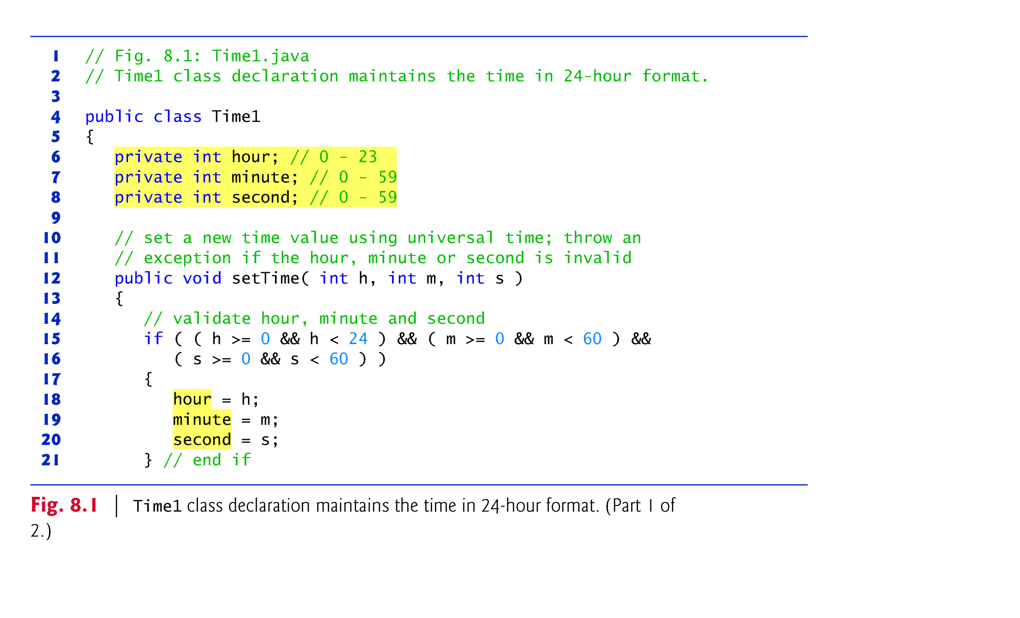

Slide 6
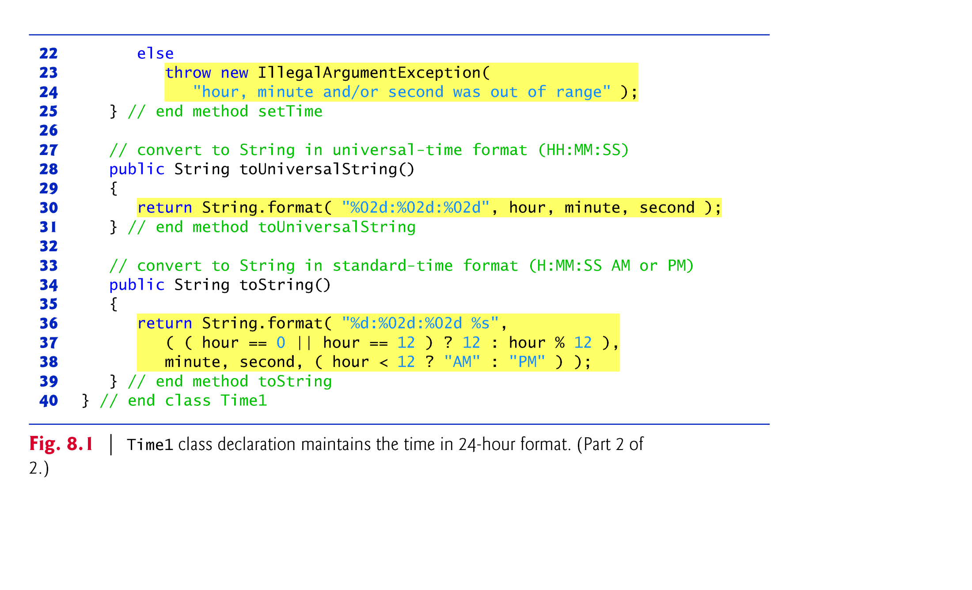

Slide 7
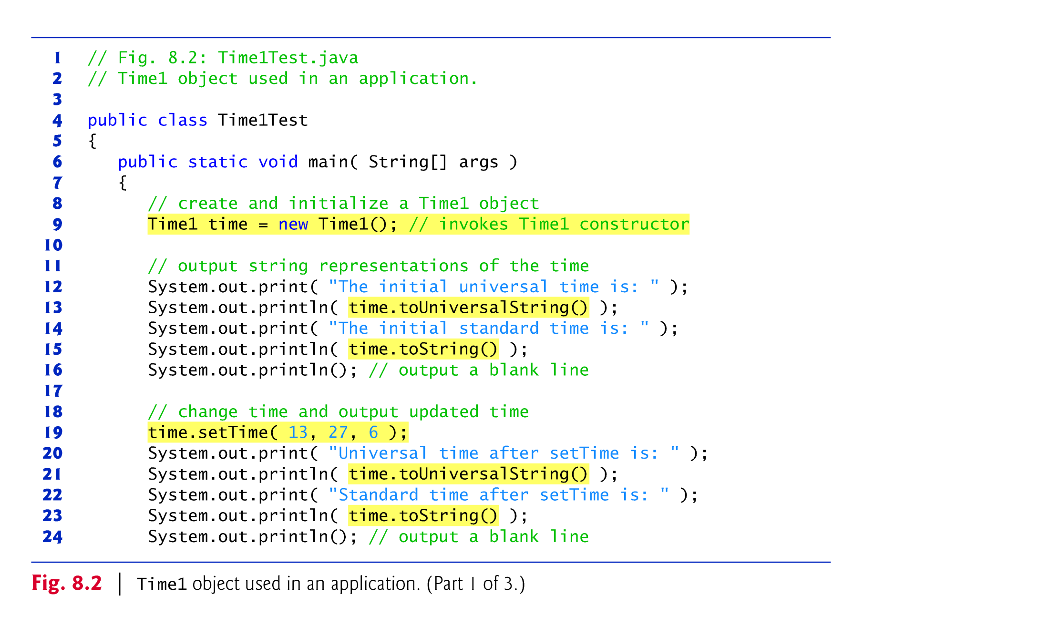

Slide 8
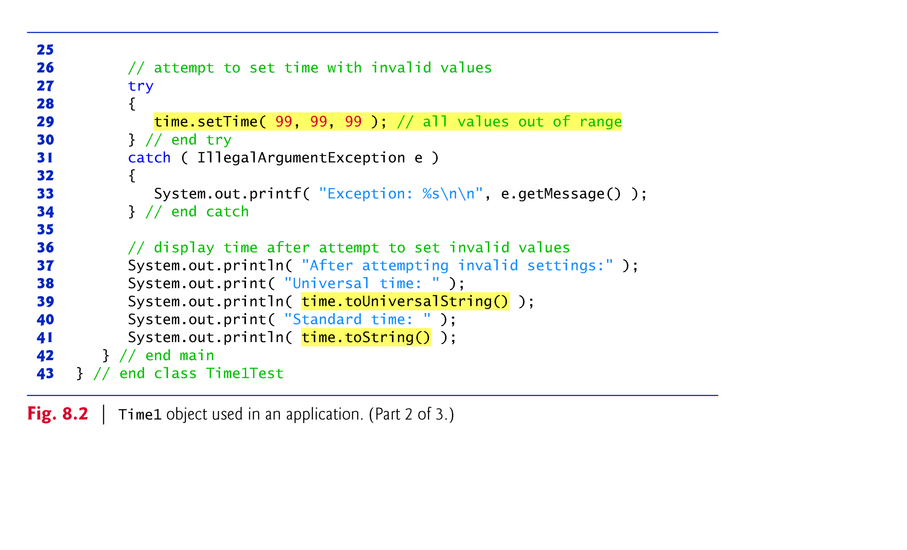

Slide 9
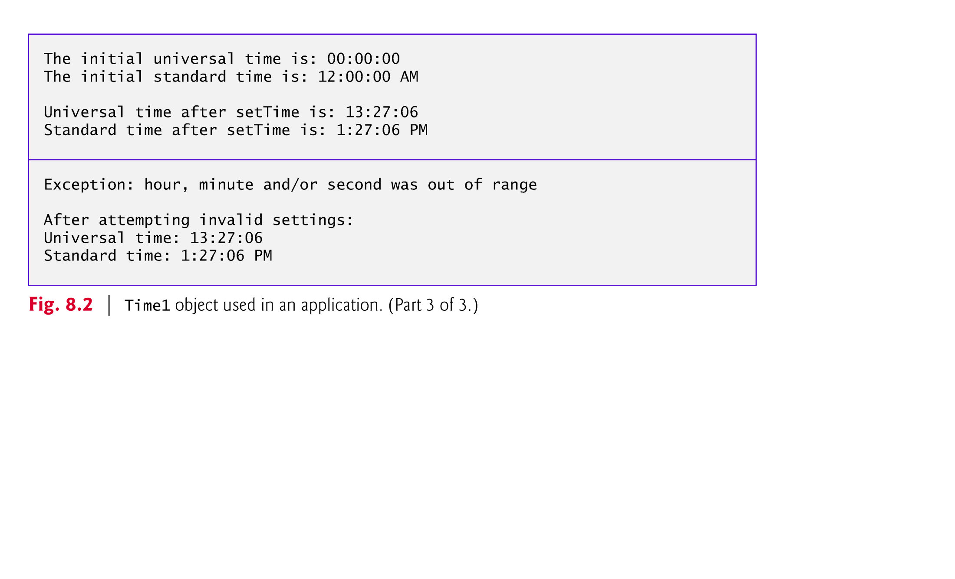

Slide 10
8.2 Time Class Case Study (Cont.)
Class Time1 does not declare a constructor, so the class has a default constructor that is supplied by the compiler.
Each instance variable implicitly receives the default value 0 for an int.
Instance variables also can be initialized when they are declared in the class body, using the same initialization syntax as with a local variable.

Slide 11
8.2 Time Class Case Study (Cont.)
Method setTime and Throwing Exceptions
For incorrect values, setTime throws an exception of type IllegalArgumentException (lines 23–24)
Notifies the client code that an invalid argument was passed to the method.
Can use try...catch to catch exceptions and attempt to recover from them.
The throw statement (line 23) creates a new object of type IllegalArgumentException. In this case, we call the constructor that allows us to specify a custom error message.
After the exception object is created, the throw statement immediately terminates method setTime and the exception is returned to the code that attempted to set the time.

Slide 12
8.2 Time Class Case Study (Cont.)
Java SE 8 introduced a new Date/ Time/ LocalDateTime… API—defined by the classes in the package java.time.
Applications built with Java SE 8 should use the Date/Time API’s capabilities.
LocalDateTime.now() Obtains the current dtae-time from the system clock in the default time-zone.

Slide 13
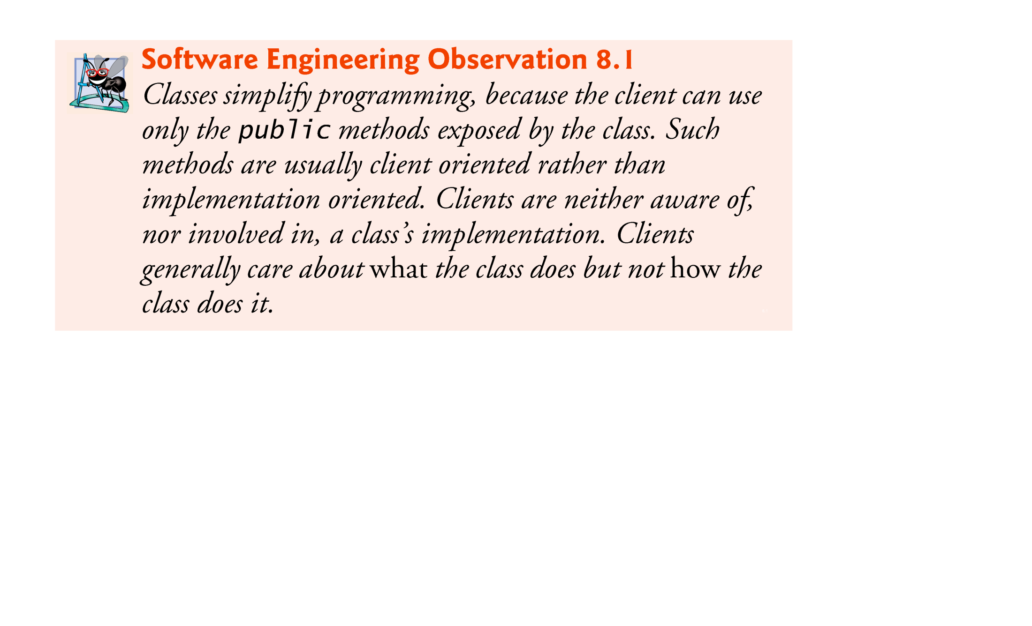

Slide 14
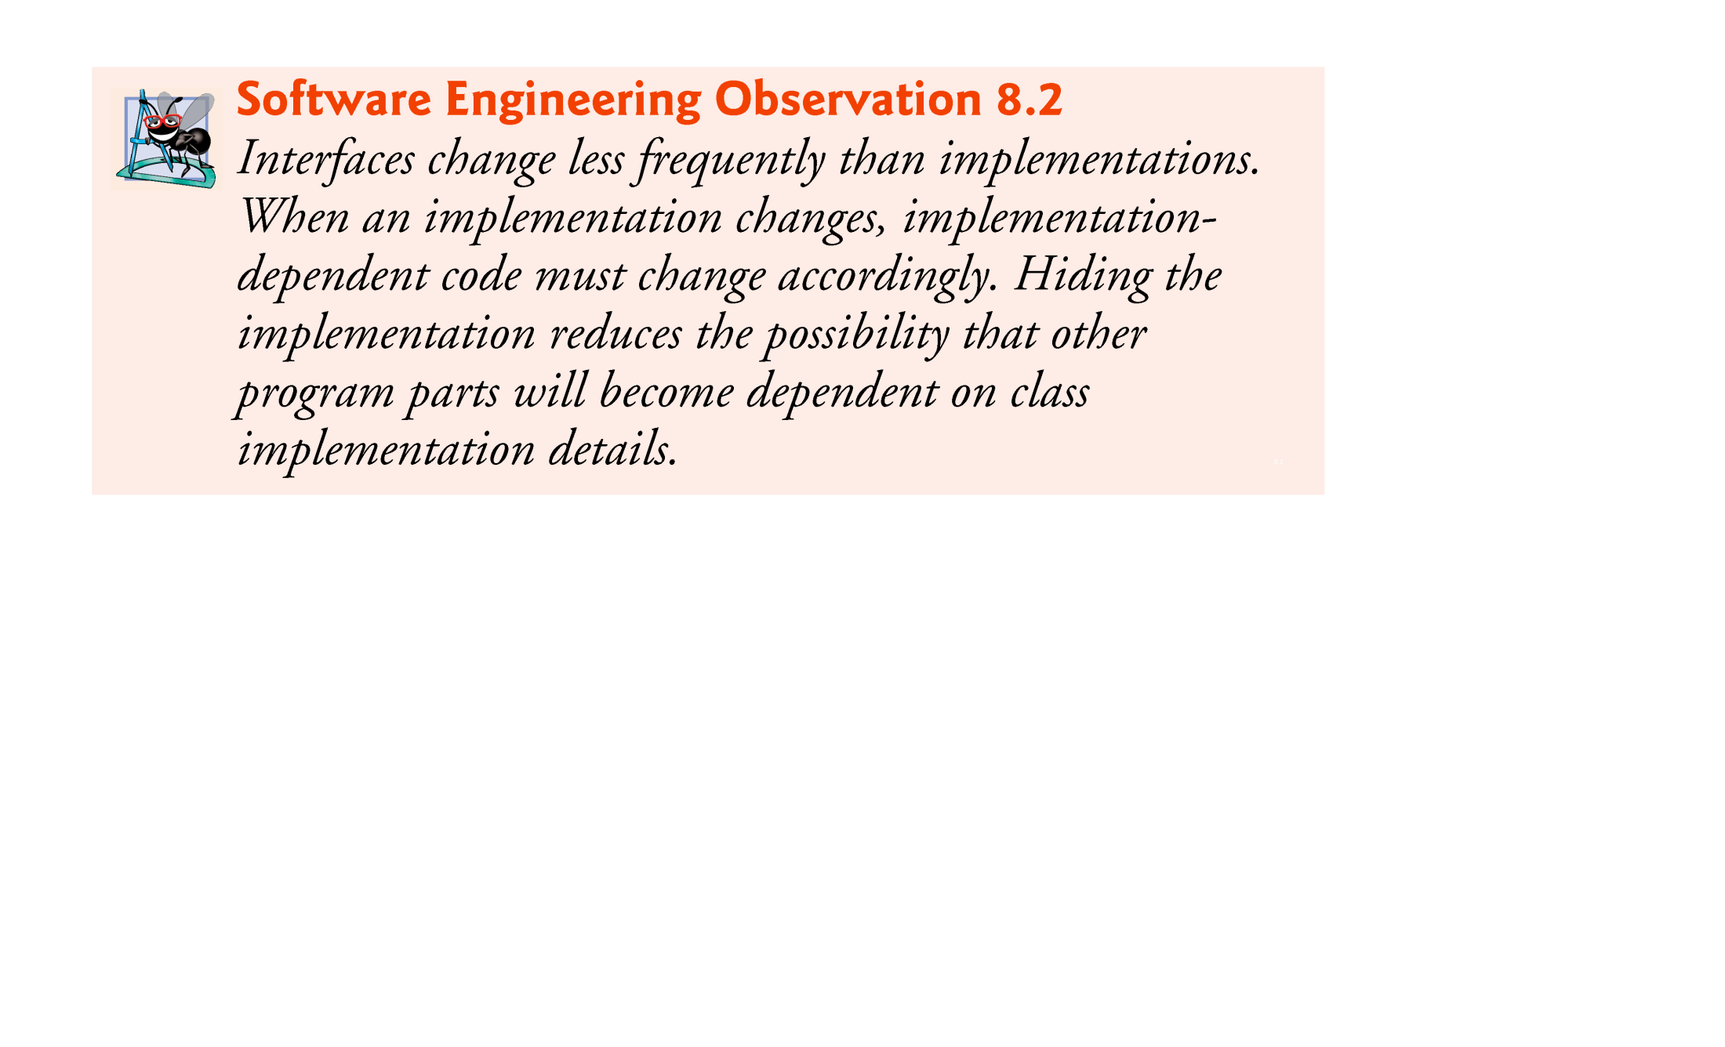

Slide 15
8.3 Controlling Access to Members
Access modifiers public and private control access to a class’s variables and methods.
Chapter 9 introduces access modifier protected.
public methods present to the class’s clients a view of the services the class provides (the class’s public interface).
Clients need not be concerned with how the class accomplishes its tasks.
For this reason, the class’s private variables and private methods (i.e., its implementation details) are not accessible to its clients.
private class members are not accessible outside the class.

Slide 16
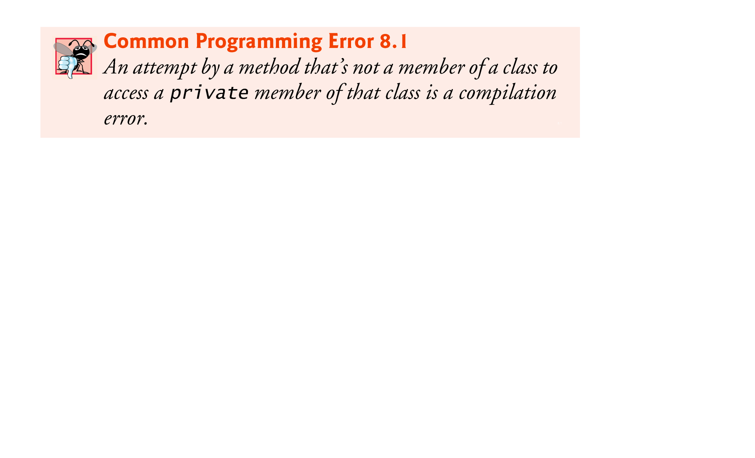

Slide 17
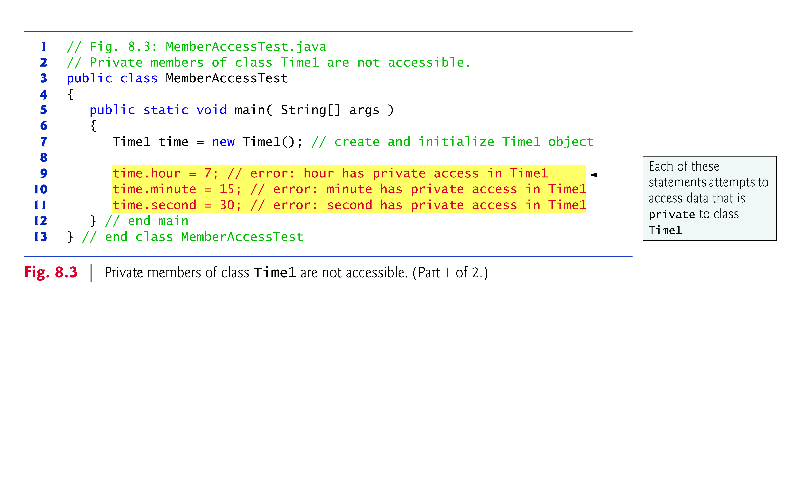

Slide 18
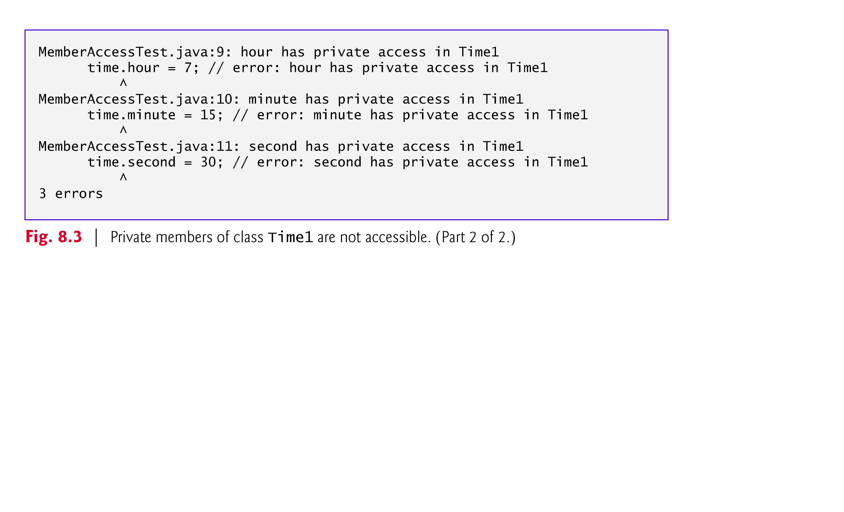

Slide 19
8.4 Referring to the Current Object’s Members with the this Reference
Every object can access a reference to itself with keyword this.
When a non-static method is called for a particular object, the method’s body implicitly uses keyword this to refer to the object’s instance variables and other methods.
Enables the class’s code to know which object should be manipulated.
Can also use keyword this explicitly in a non-static method’s body.
Can use the this reference implicitly and explicitly.

Slide 20
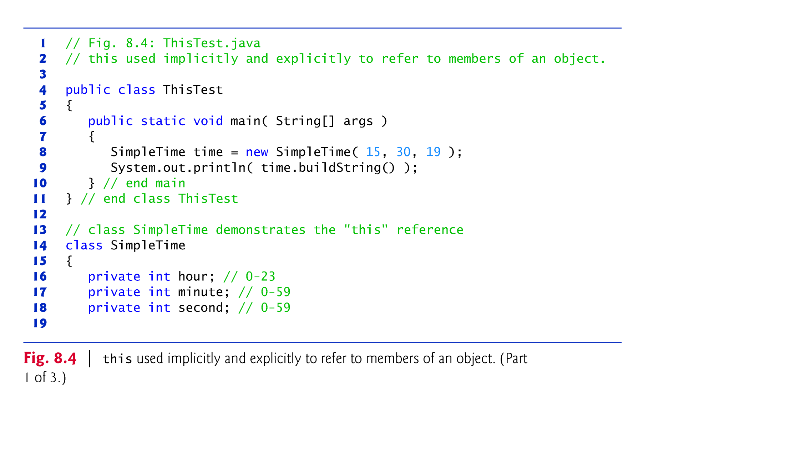

Slide 21
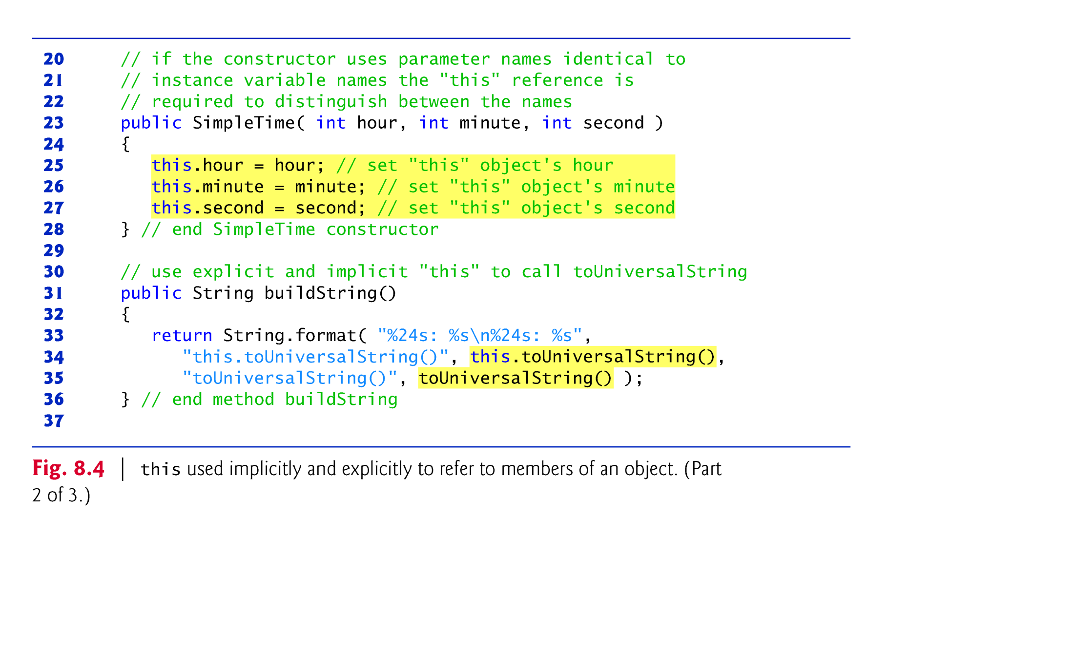

Slide 22
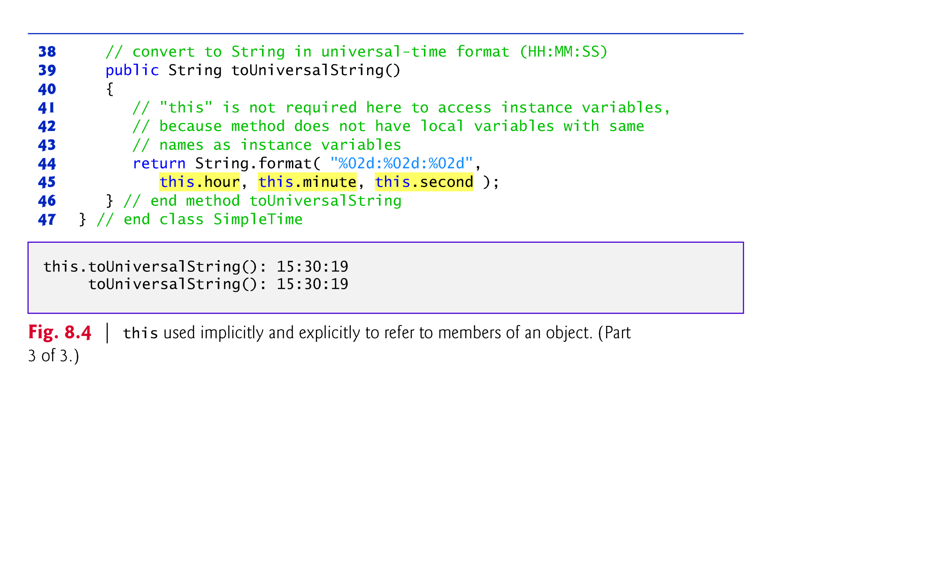

Slide 23
8.4 Referring to the Current Object’s Members with the this Reference (Cont.)
SimpleTime declares three private instance variables—hour, minute and second.
If parameter names for the constructor that are identical to the class’s instance-variable names.
We don’t recommend this practice
Use it here to shadow (hide) the corresponding instance
Illustrates a case in which explicit use of the this reference is required.
If a method contains a local variable with the same name as a field, that method uses the local variable rather than the field.
The local variable shadows the field in the method’s scope.
A method can use the this reference to refer to the shadowed field explicitly.

Slide 24
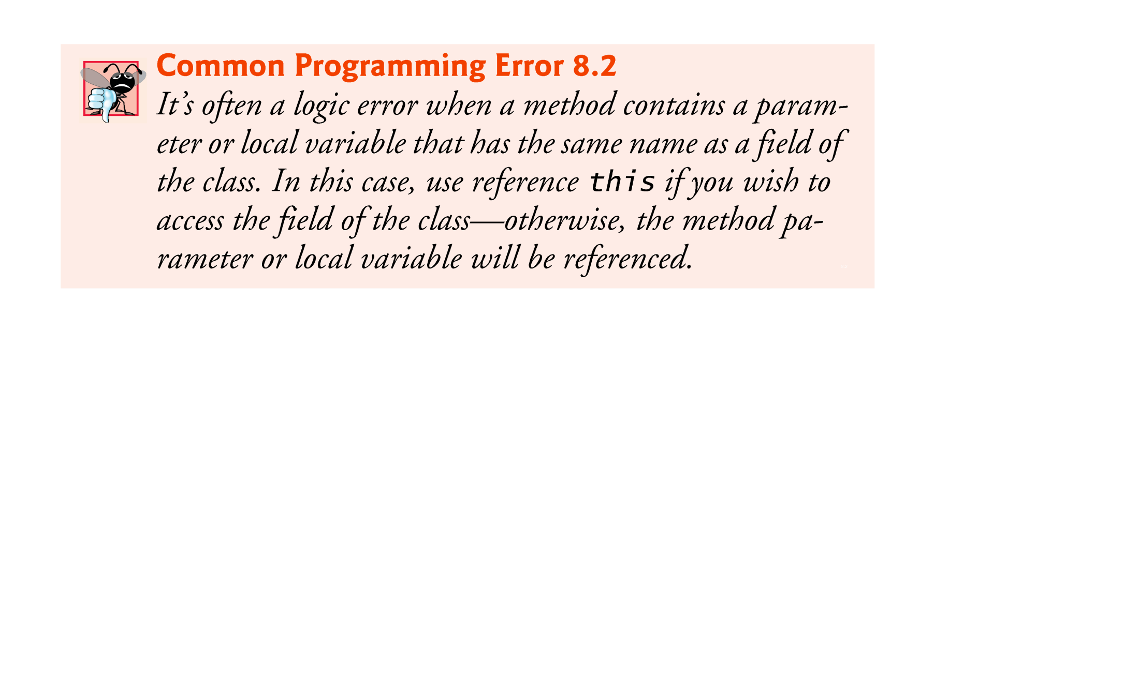

Slide 25
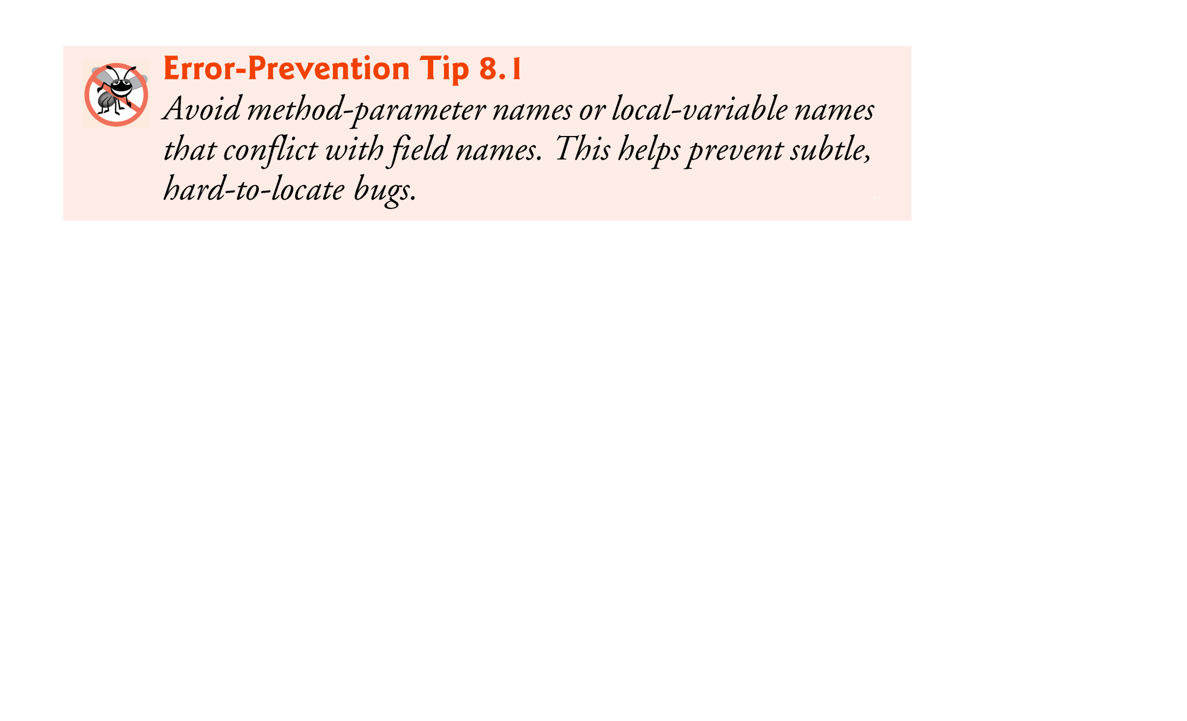

Slide 26
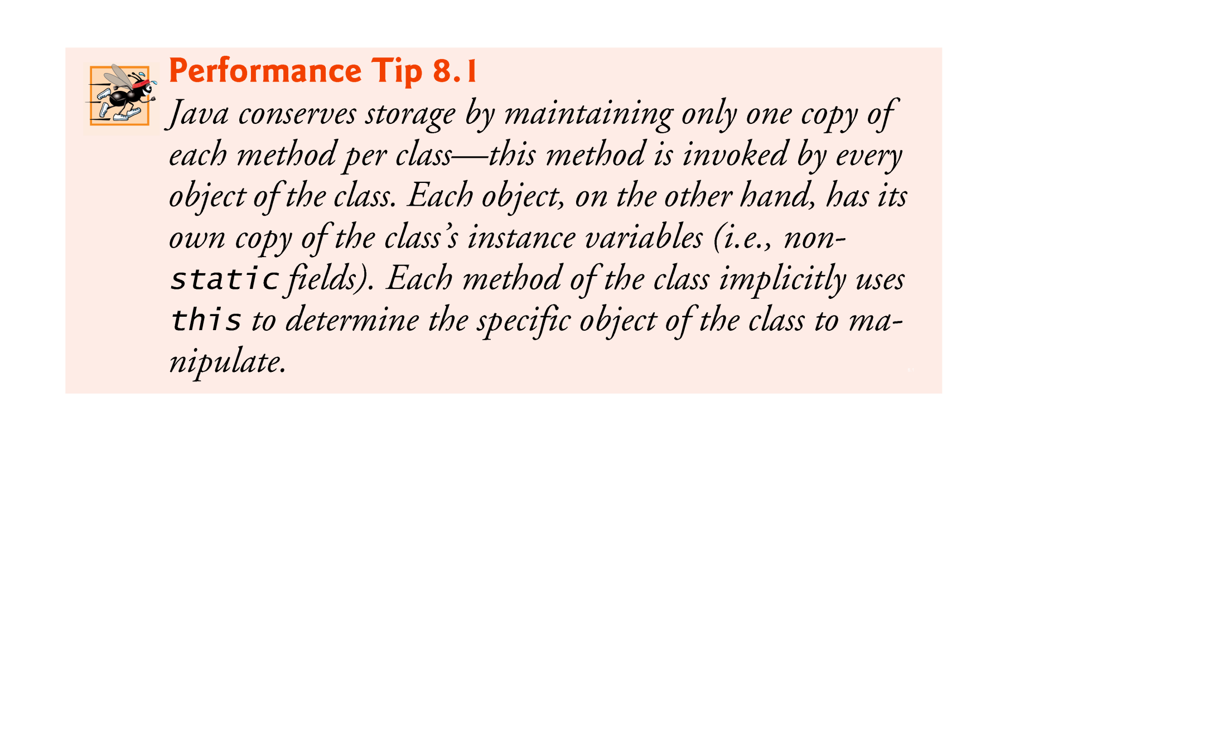

Slide 27
8.5 Time Class Case Study: Overloaded Constructors
Overloaded constructors enable objects of a class to be initialized in different ways.
To overload constructors, simply provide multiple constructor declarations with different signatures.
The compiler invokes the appropriate constructor by matching the number, types and order of the types of the arguments specified in the constructor call with the number, types and order of the types of the parameters specified in each constructor declaration.

Slide 28
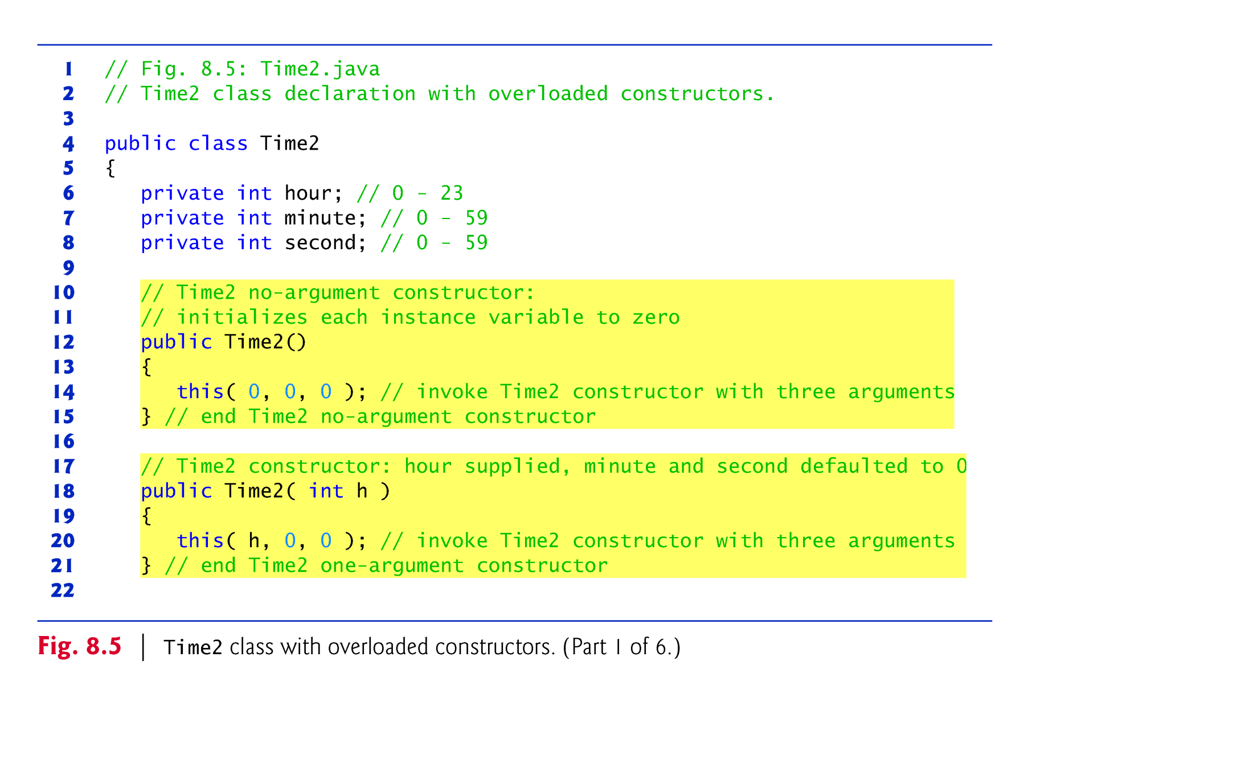

Slide 29
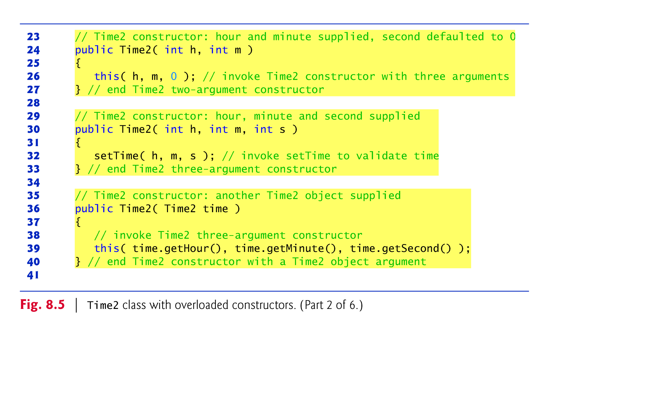

Slide 30
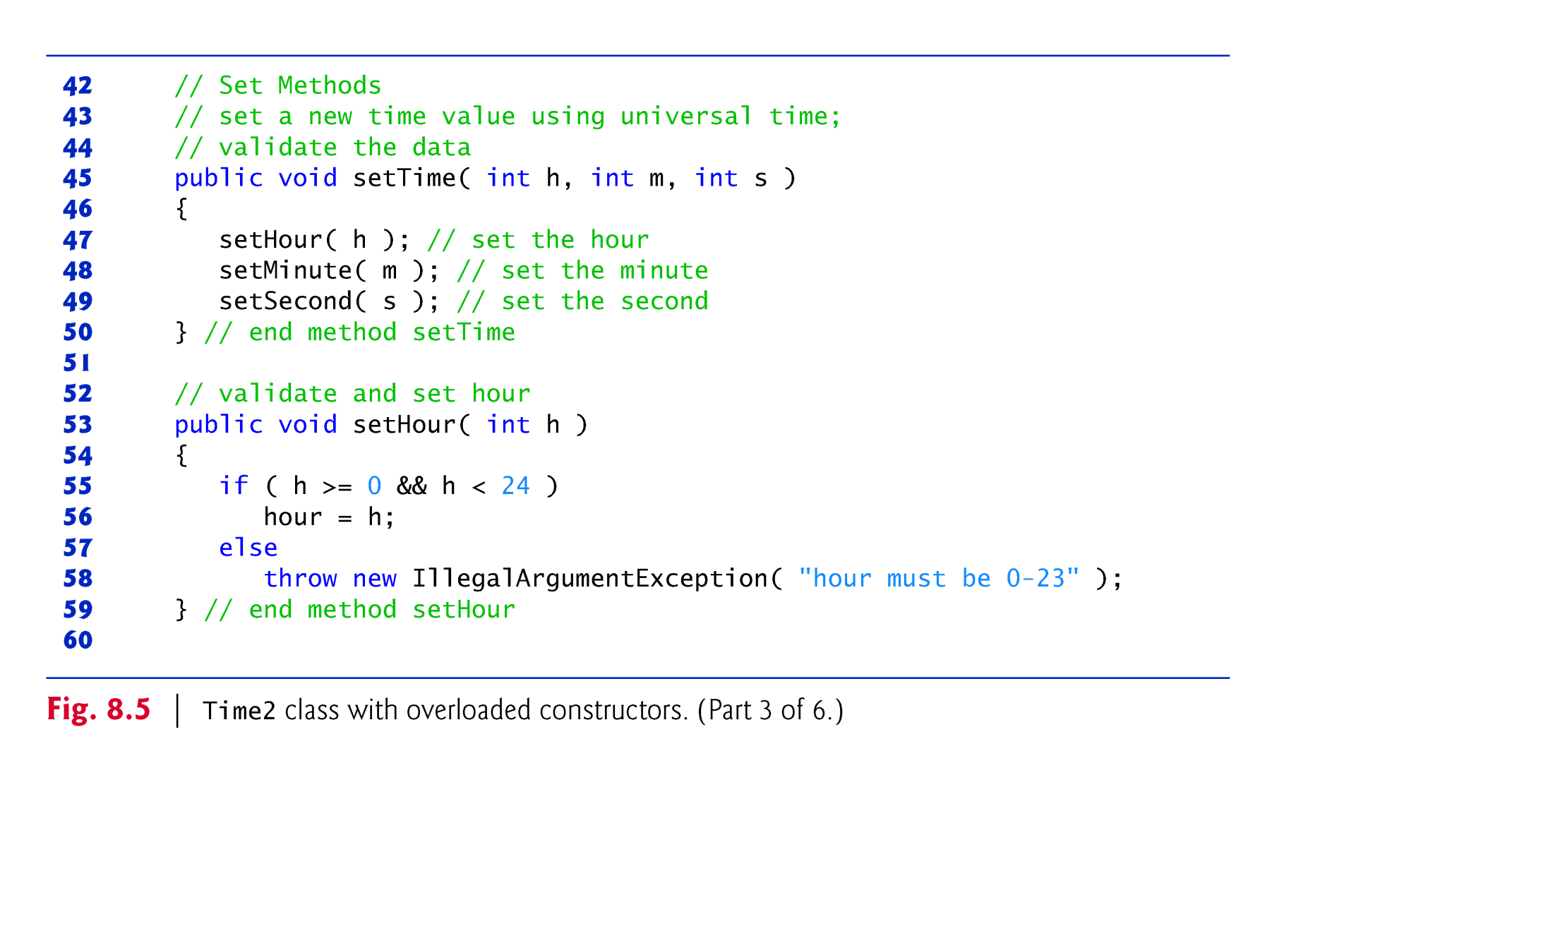

Slide 31
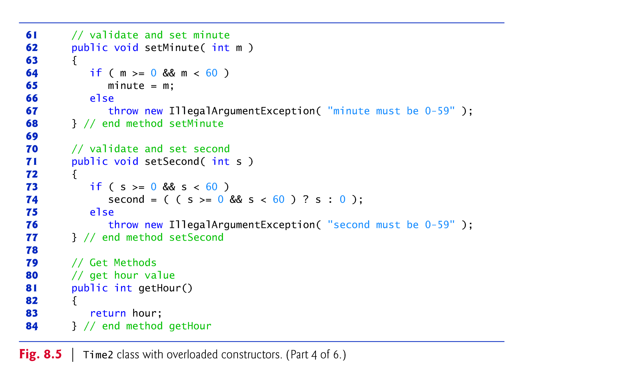

Slide 32
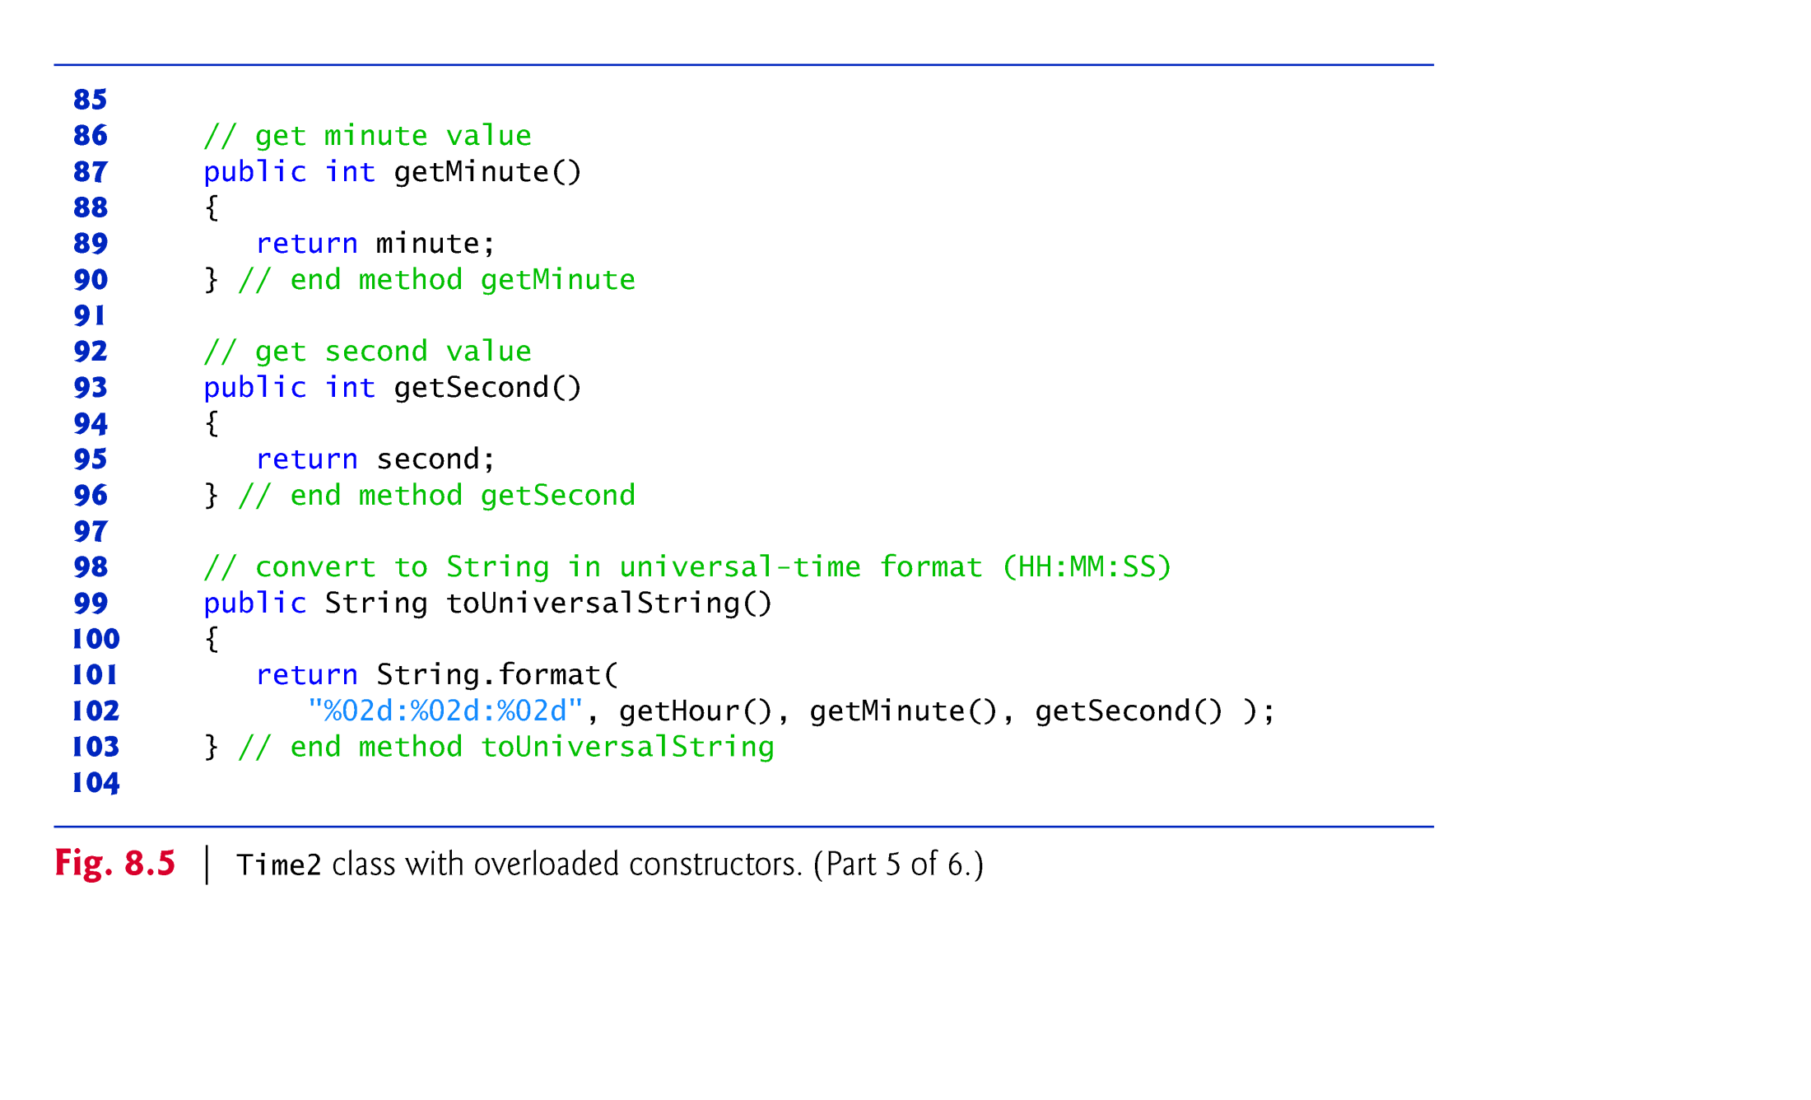

Slide 33
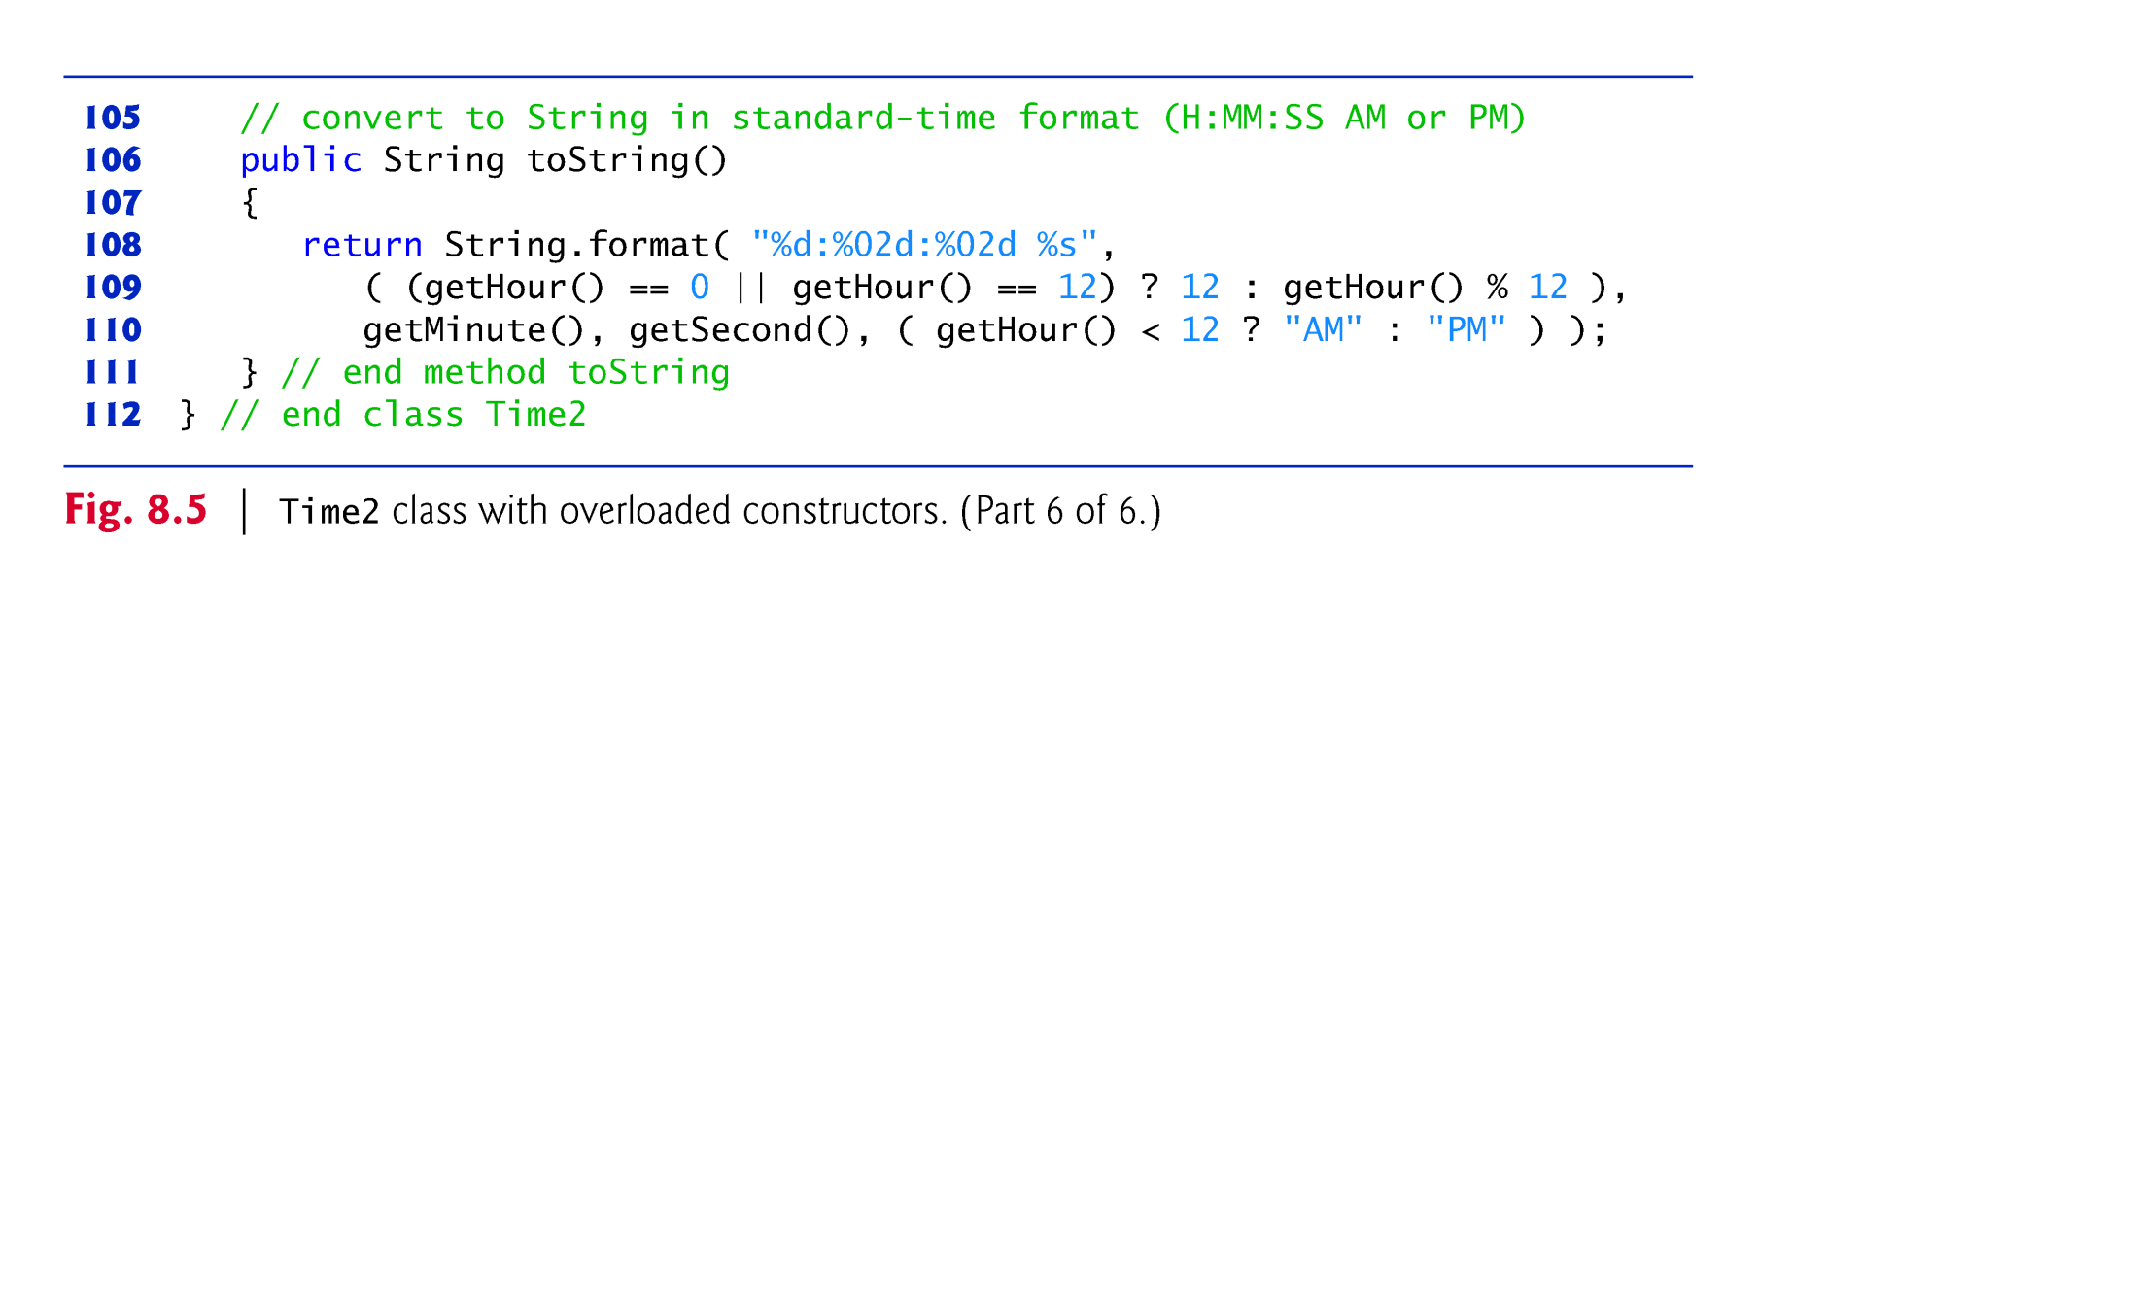

Slide 34


Slide 35


Slide 36
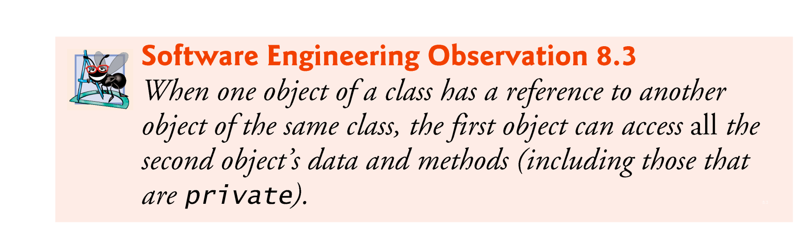
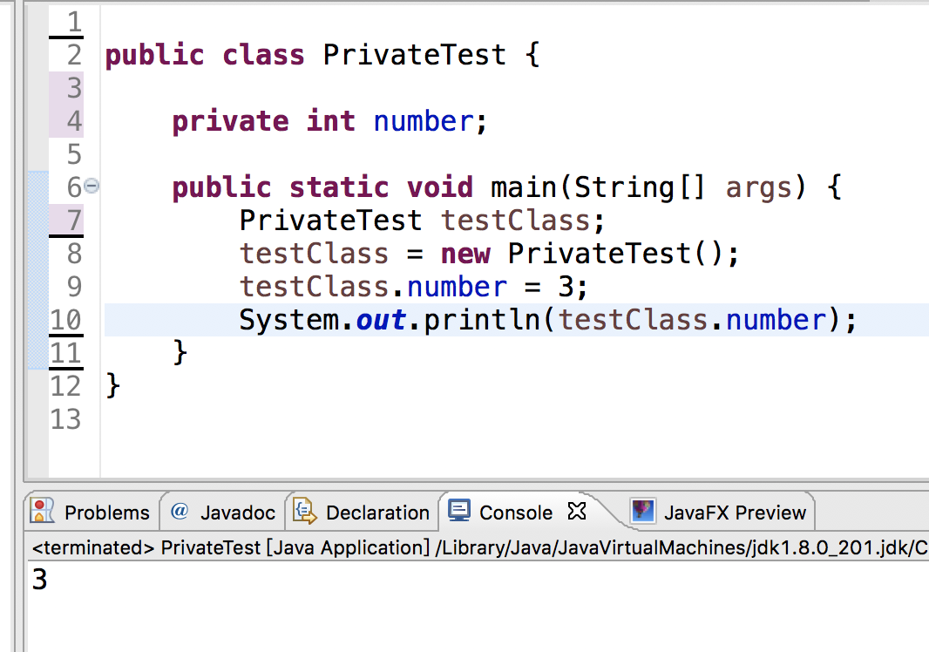

Slide 37


Slide 38
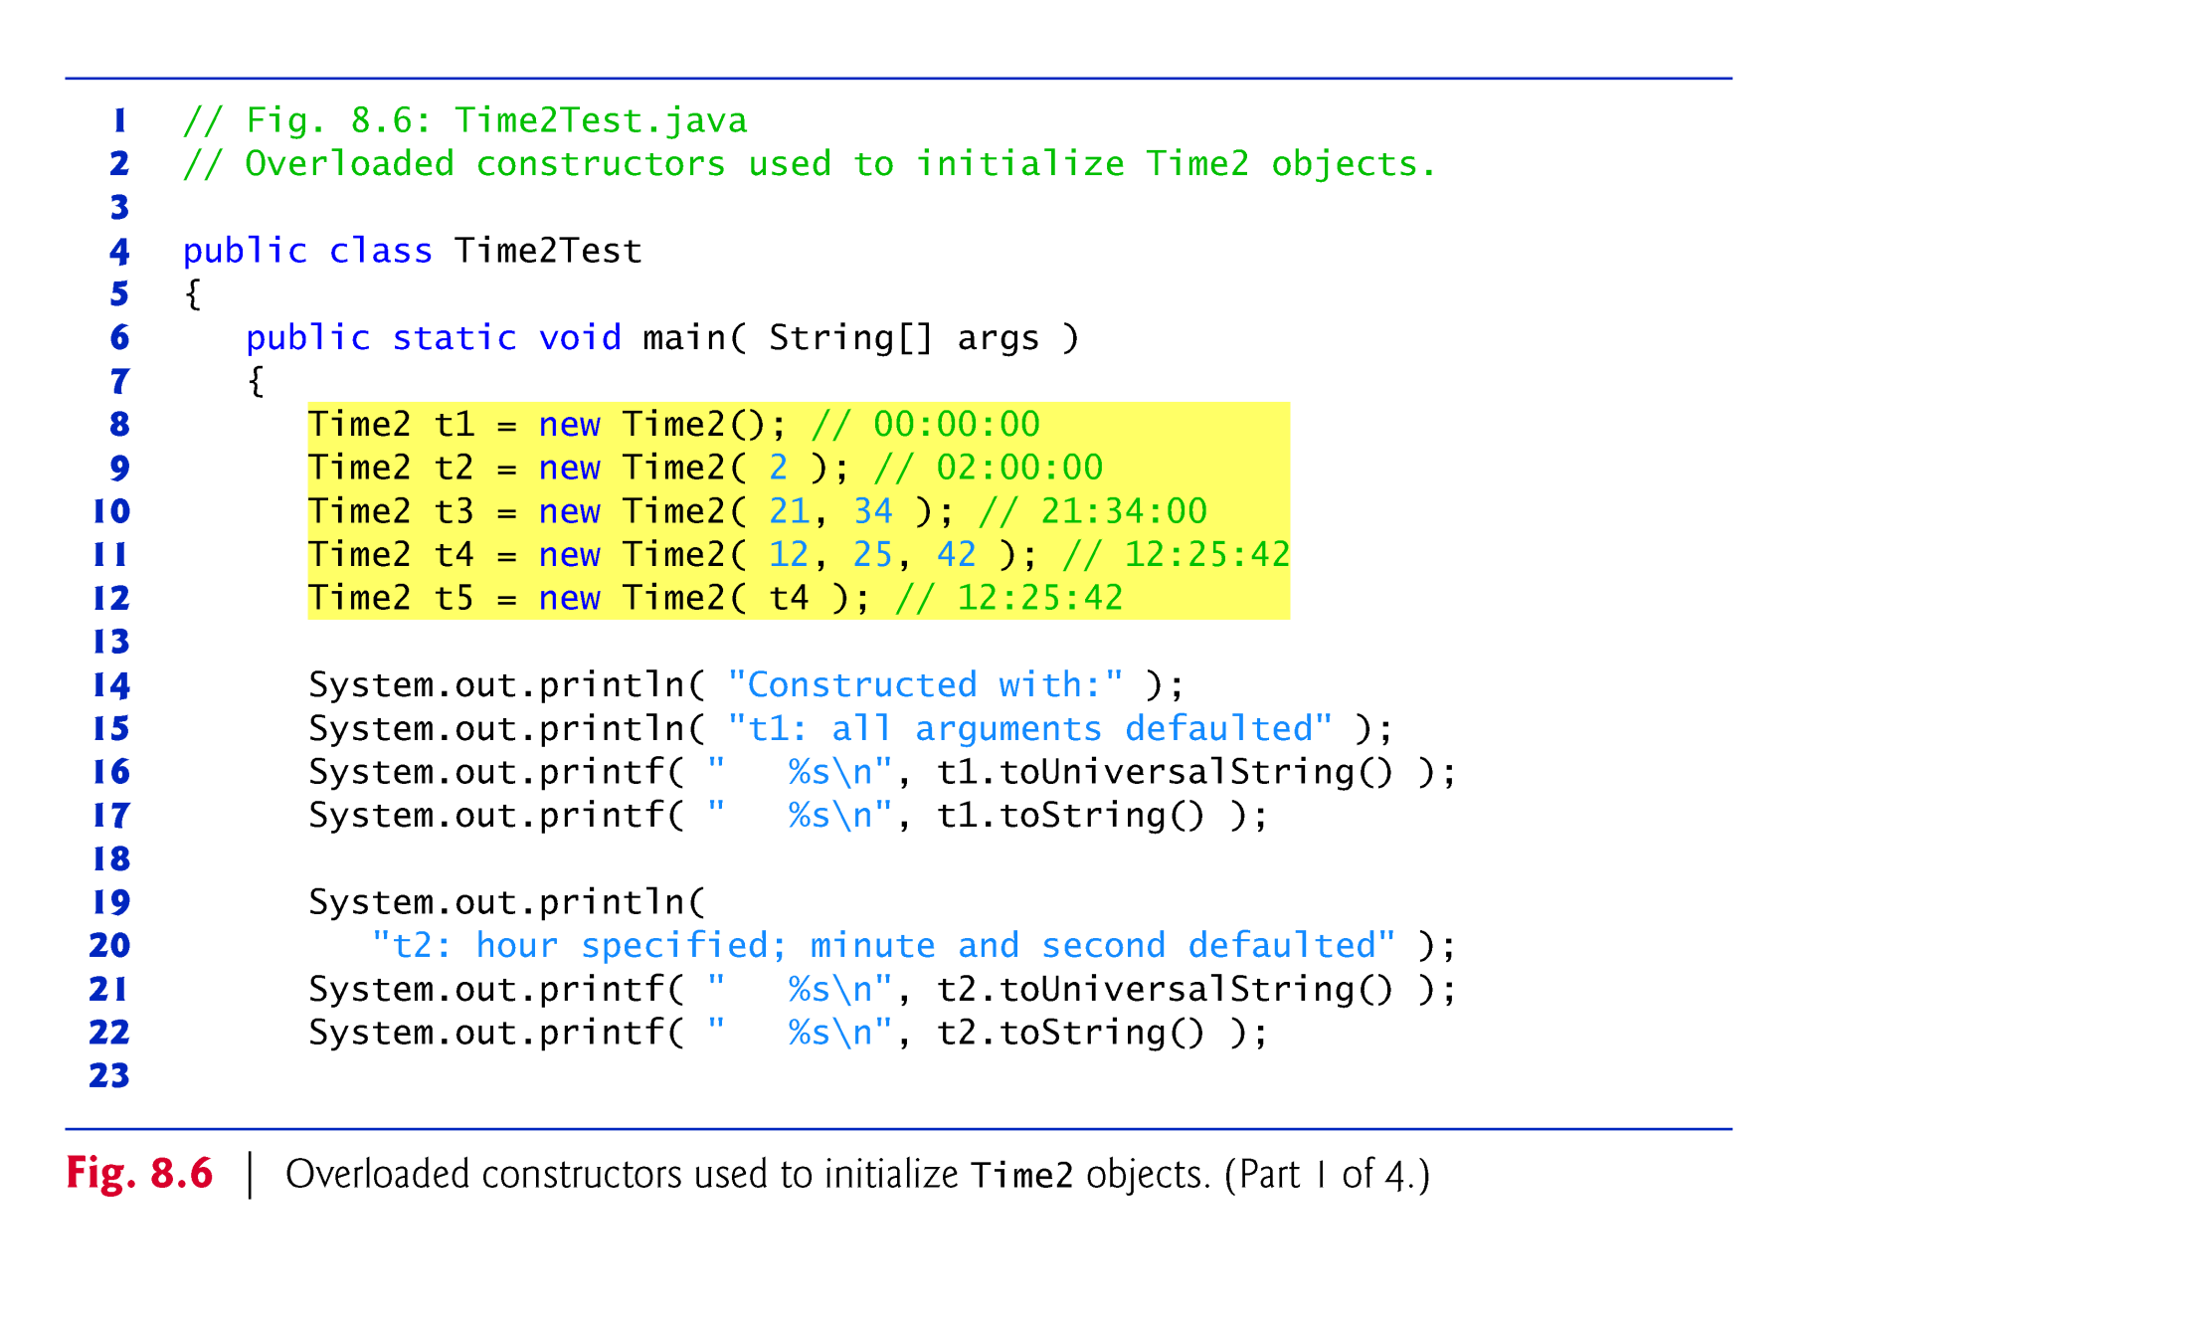

Slide 39
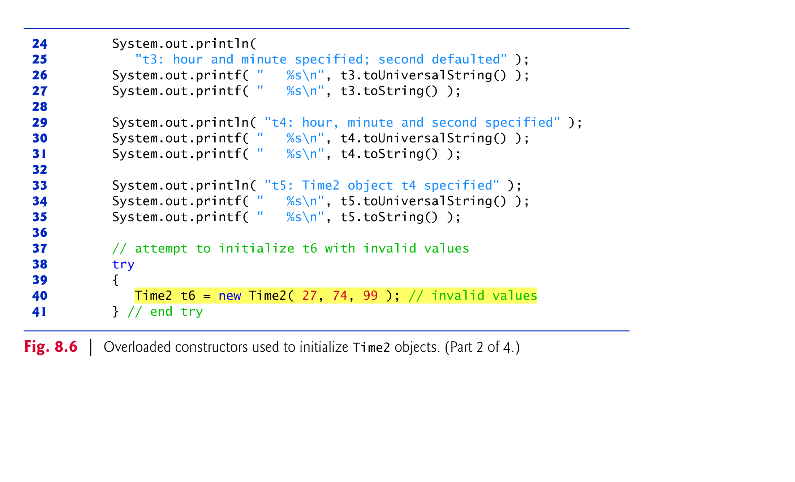

Slide 40
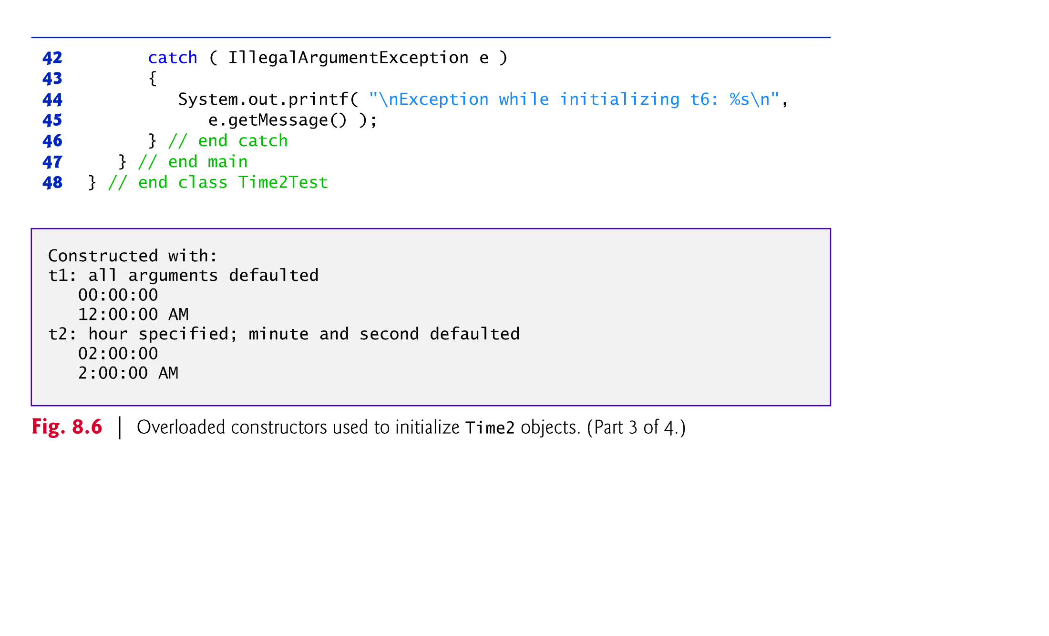

Slide 41
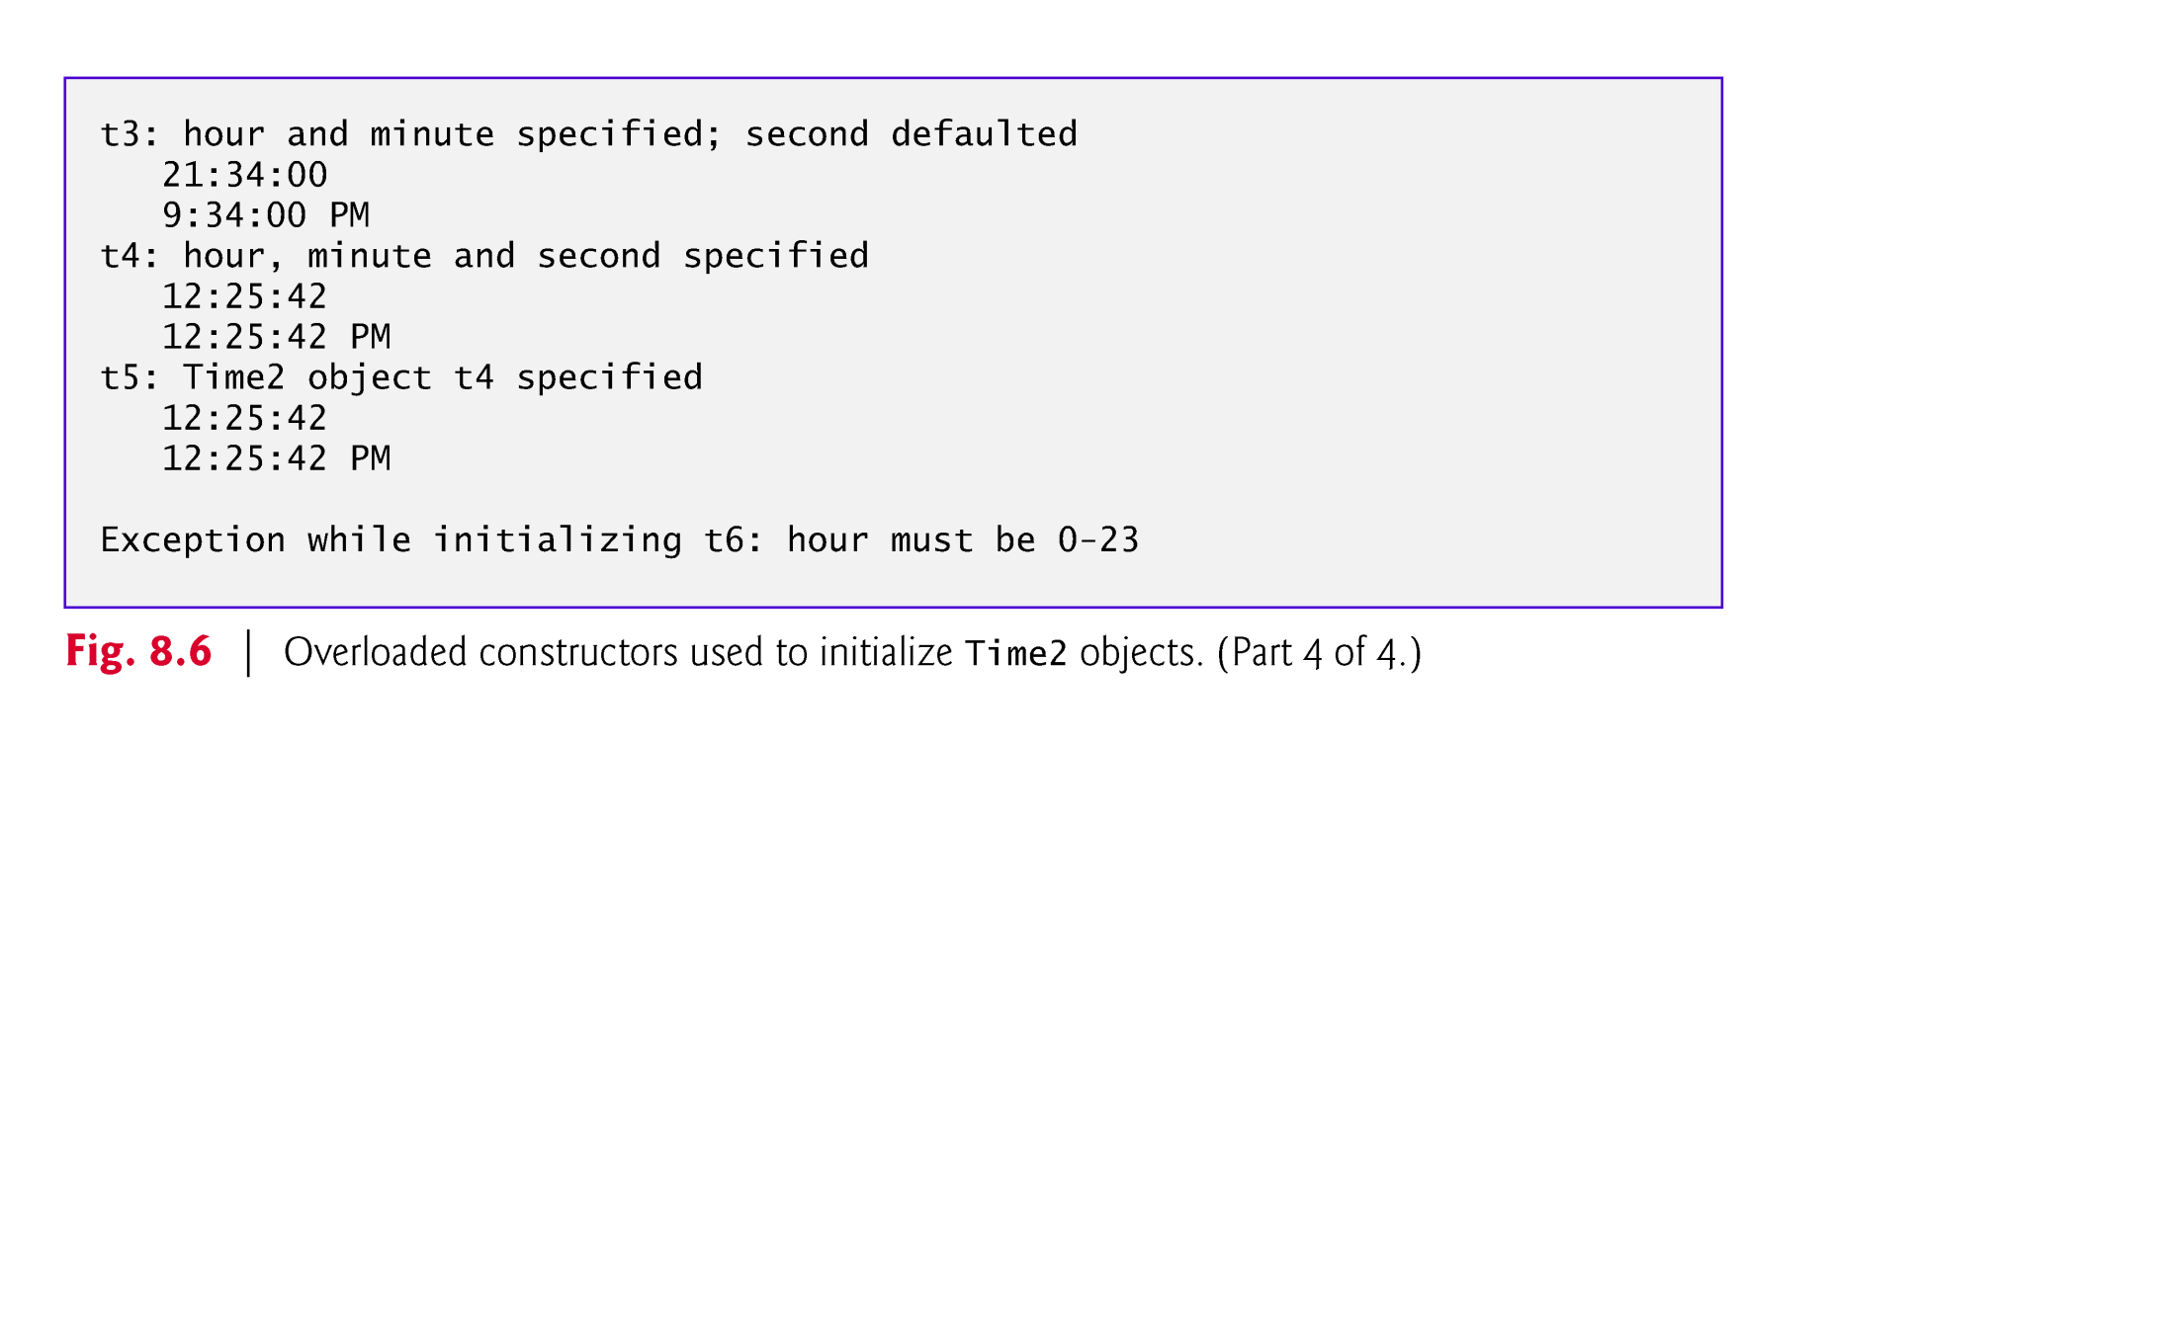

Slide 42
8.6 Default and No-Argument Constructors
Every class must have at least one constructor.
If you do not provide any constructors in a class’s declaration, the compiler creates a default constructor that takes no arguments when it’s invoked.
The default constructor initializes the instance variables to the initial values specified in their declarations or to their default values (zero for primitive numeric types, false for boolean values and null for references).
If your class declares constructors, the compiler will not create a default constructor.
In this case, you must declare a no-argument constructor if default initialization is required.
Like a default constructor, a no-argument constructor is invoked with empty parentheses.

Slide 43


Slide 44
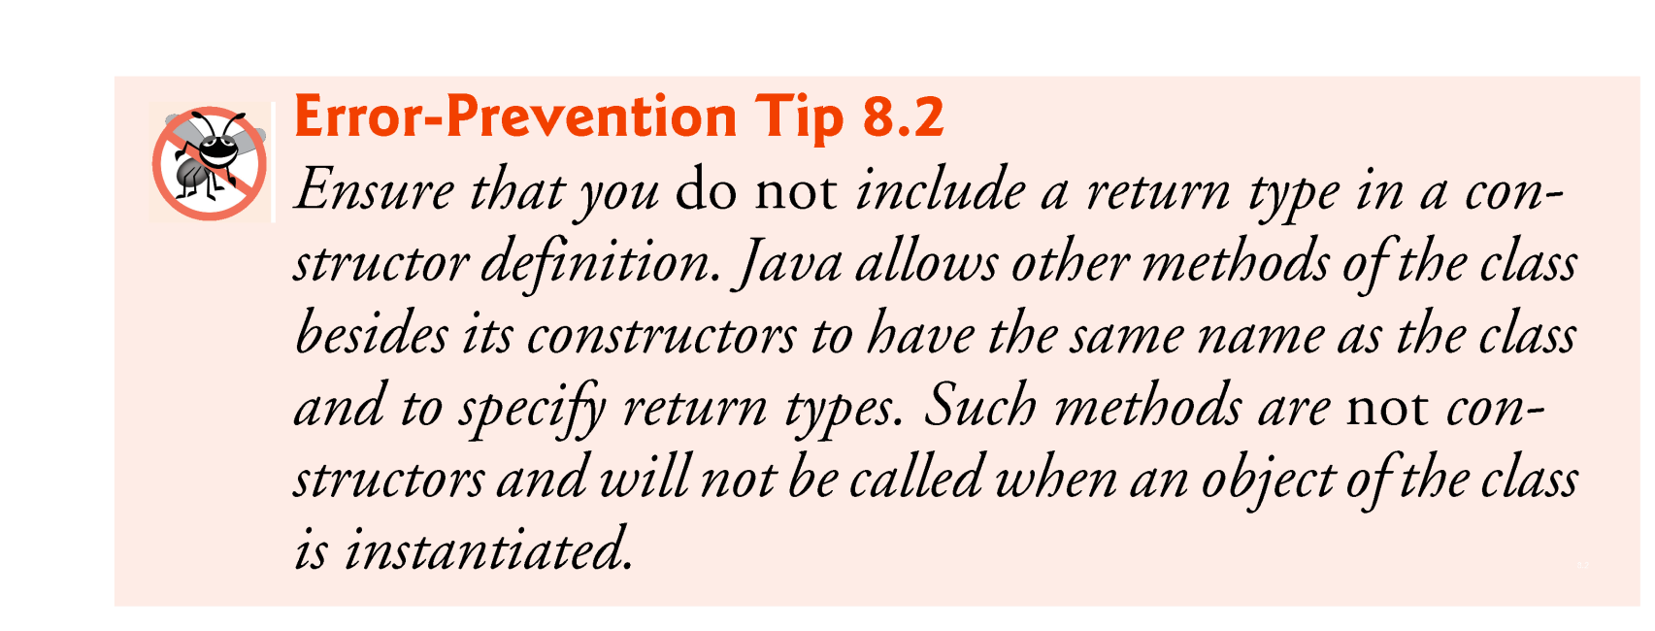

Slide 45
8.7 Notes on Set and Get Methods
Classes often provide public methods to allow clients of the class to set (i.e., assign values to) or get (i.e., obtain the values of) private instance variables.
Set methods are also commonly called mutator methods, because they typically change an object’s state—i.e., modify the values of instance variables.
Get methods are also commonly called accessor methods or query methods.

Slide 46
8.7 Notes on Set and Get Methods (Cont.)
It would seem that providing set and get capabilities is essentially the same as making the instance variables public.
A public instance variable can be read or written by any method that has a reference to an object that contains that variable.
If an instance variable is declared private, a public get method certainly allows other methods to access it, but the get method can control how the client can access it.
A public set method can—and should—carefully scrutinize at-tempts to modify the variable’s value to ensure valid values.
Although set and get methods provide access to private data, it is restricted by the implementation of the methods.

Slide 47
8.7 Notes on Set and Get Methods (Cont.)
Validity Checking in Set Methods
The benefits of data integrity do not follow automatically simply because instance variables are declared private—you must provide validity checking.
Predicate Methods
Another common use for accessor methods is to test whether a condition is true or false—such methods are often called predicate methods.
Example: ArrayList’s isEmpty method, which returns true if the ArrayList is empty.

Slide 48
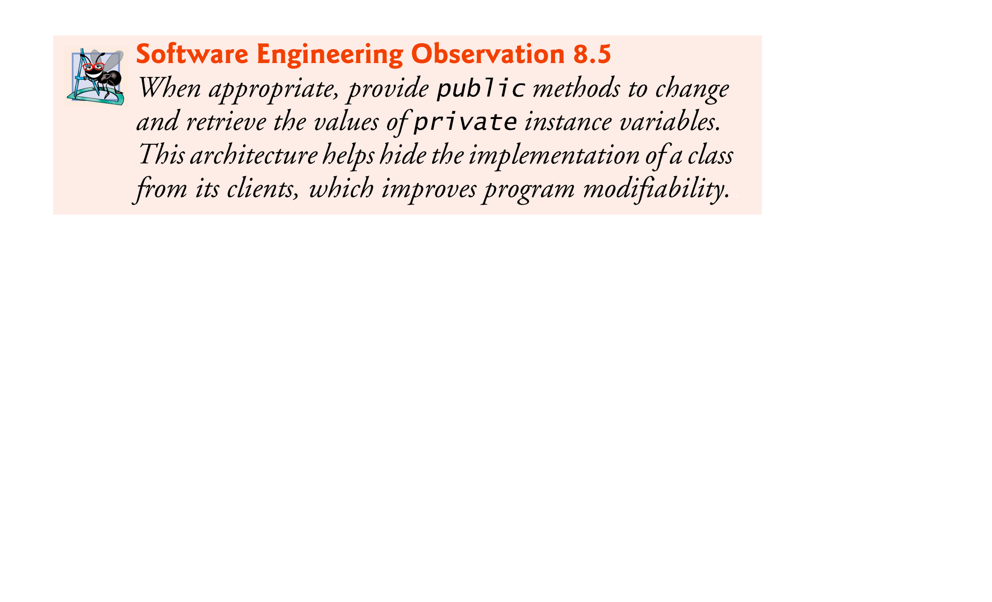

Slide 49
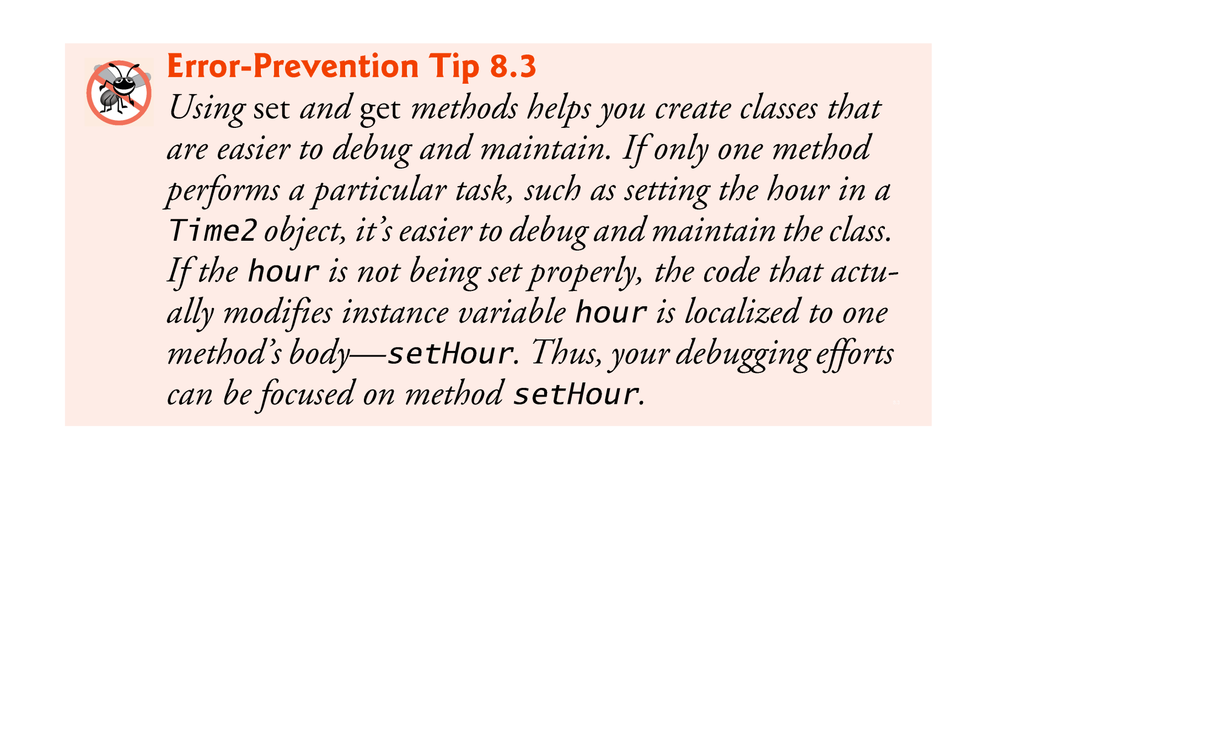

Slide 50
8.8 Composition
A class can have references to objects of other classes as members.
This is called composition and is sometimes referred to as a has-a relationship.
Example: An AlarmClock object needs to know the current time and the time when it’s supposed to sound its alarm, so it’s reasonable to include two references to Time objects in an AlarmClock object.

Slide 51
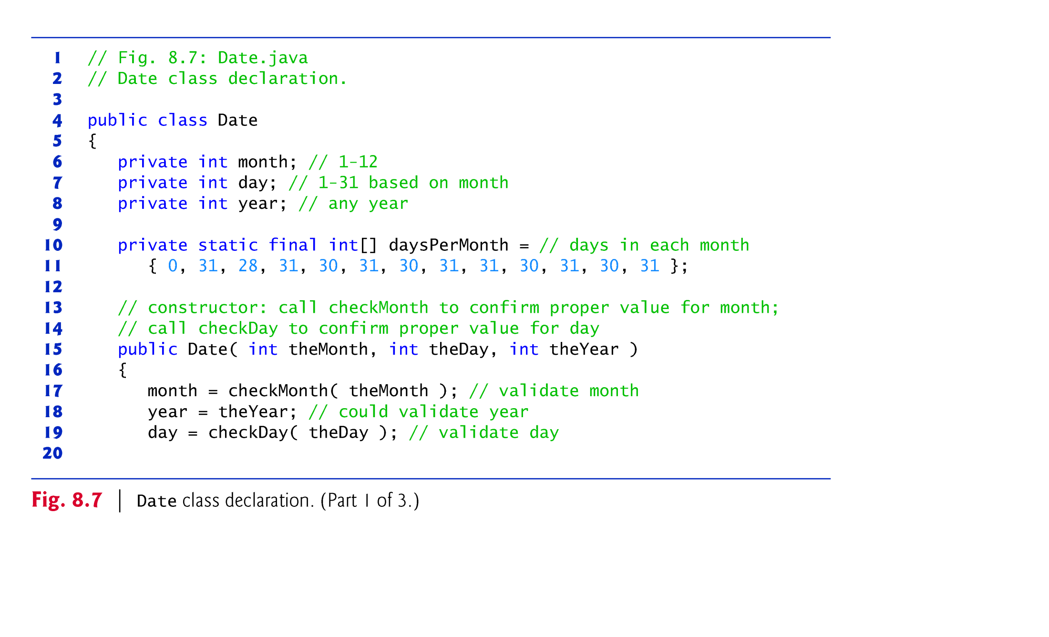

Slide 52
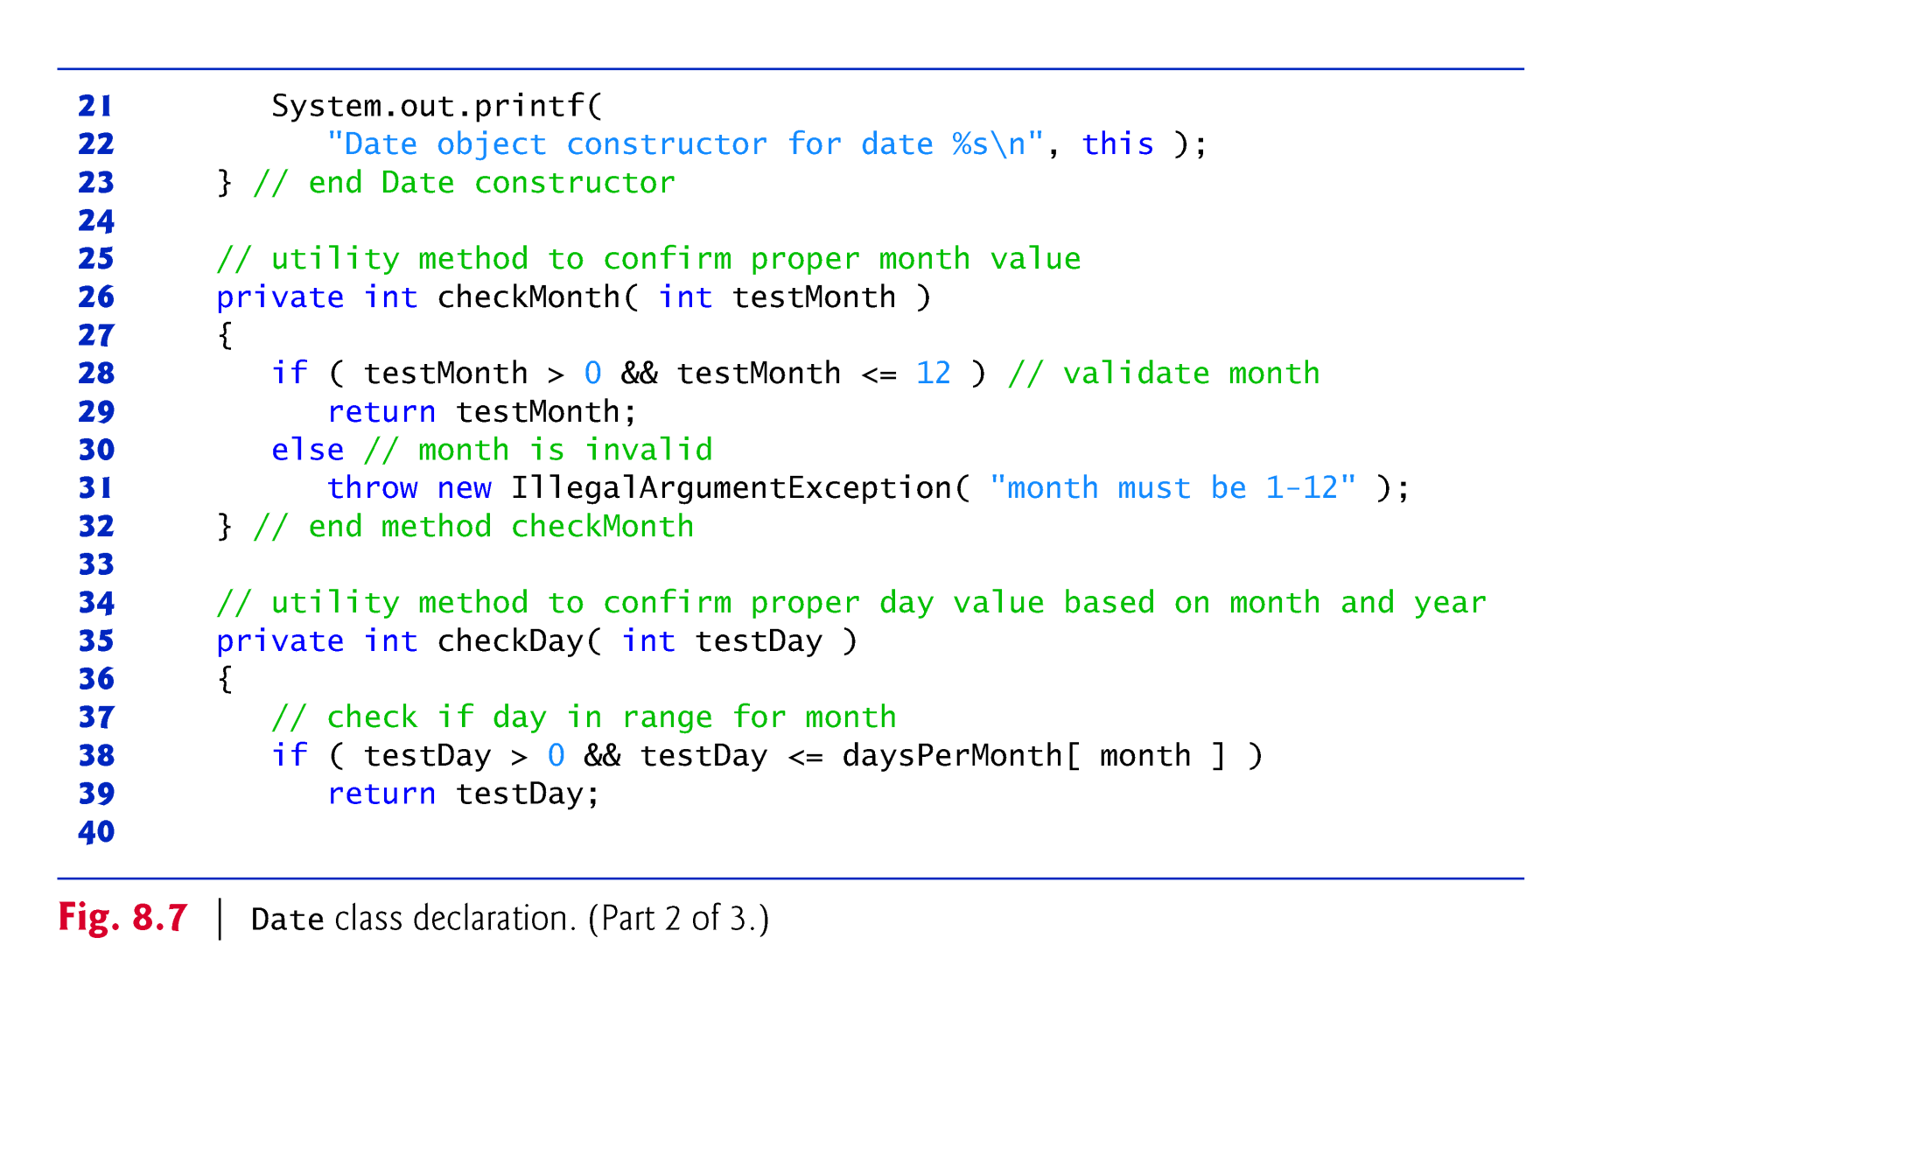

Slide 53
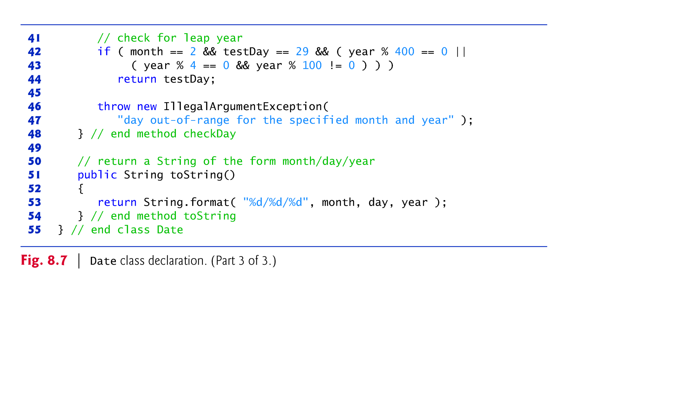

Slide 54
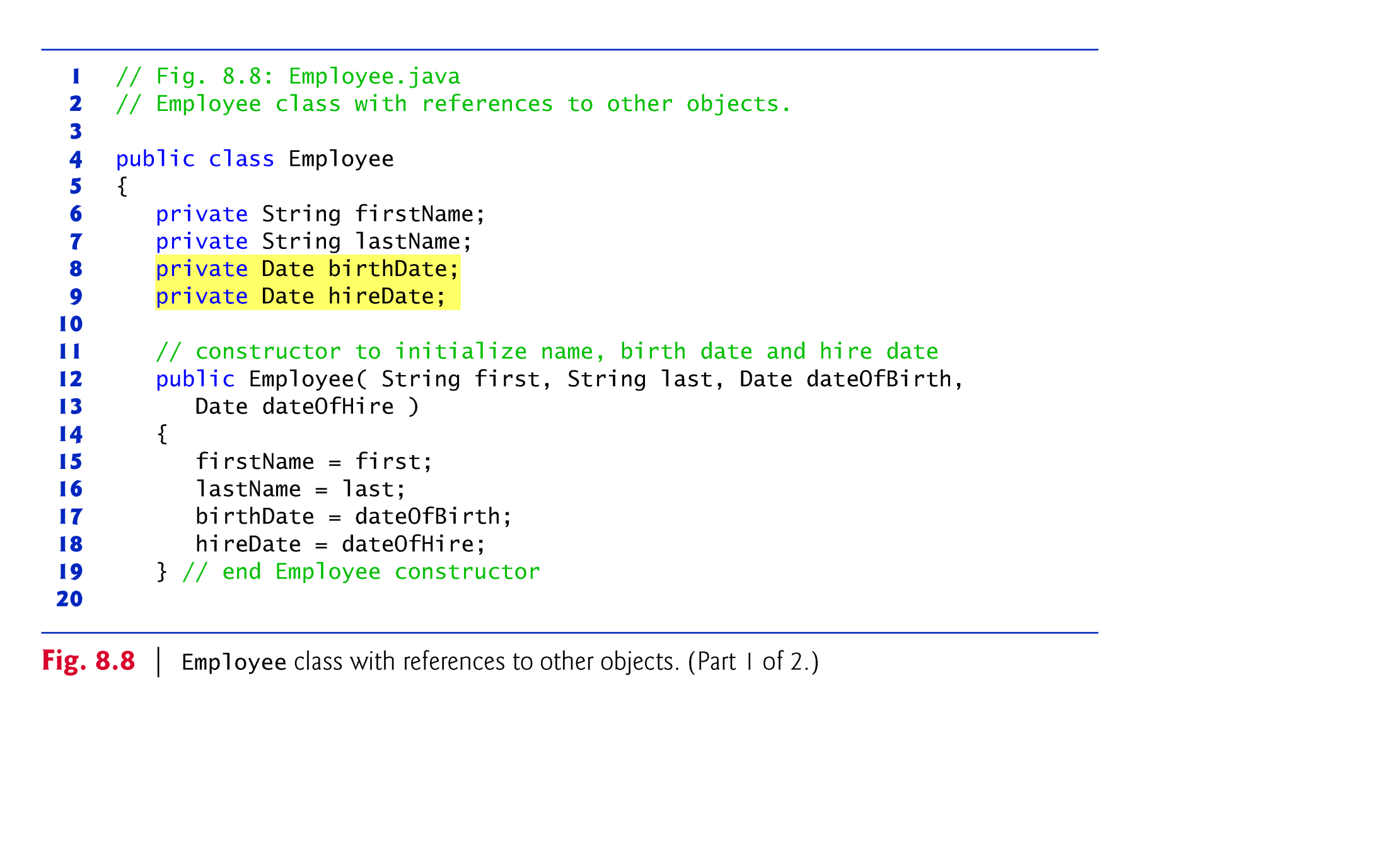

Slide 55
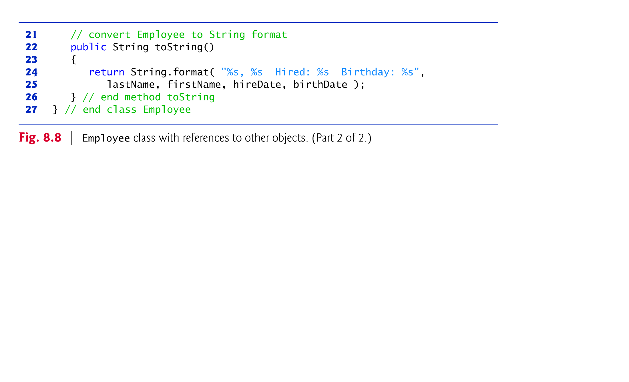

Slide 56
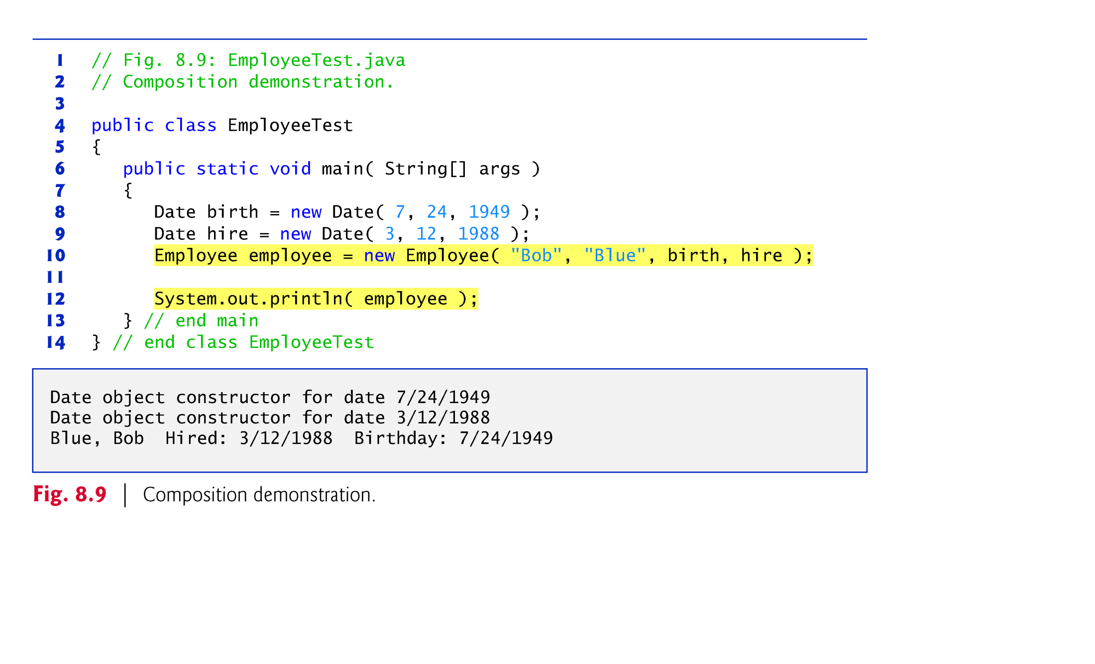

Slide 57
8.9 Enum Type
The basic enum type defines a set of constants represented as unique identifiers.
Like classes, all enum types are reference types.
An enum type is declared with an enum declaration, which is a comma-separated list of enum constants
The declaration may optionally include other components of traditional classes, such as constructors, fields and methods.

Slide 58
8.9 Enum Type (Cont.)
Each enum declaration declares an enum class with the following restrictions:
enum constants are implicitly final, because they declare constants that shouldn’t be modified.
enum constants are implicitly static.
Any attempt to create an object of an enum type with operator new results in a compilation error.
enum constants can be used anywhere constants can be used, such as in the case labels of switch statements and to control enhanced for statements.
enum declarations contain two parts—the enum constants and the other members of the enum type.
An enum constructor can specify any number of parameters and can be overloaded.

Slide 59
8.9 Enum Type (Cont.)
For every enum, the compiler generates the static method values that returns an array of the enum’s constants.
When an enum constant is converted to a String, the constant’s identifier is used as the String representation.

Slide 60
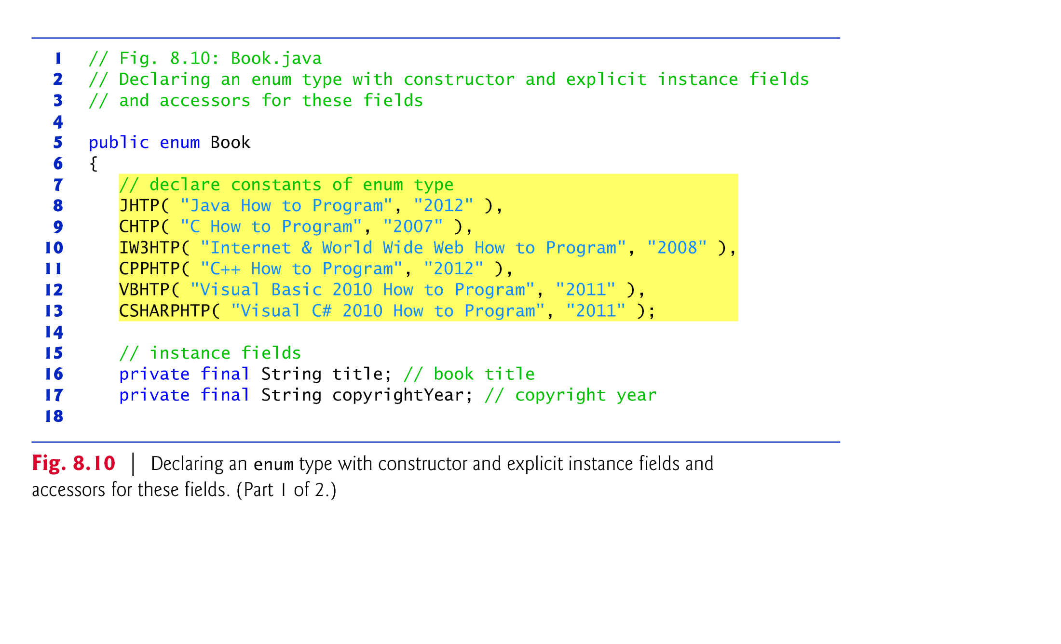

Slide 61
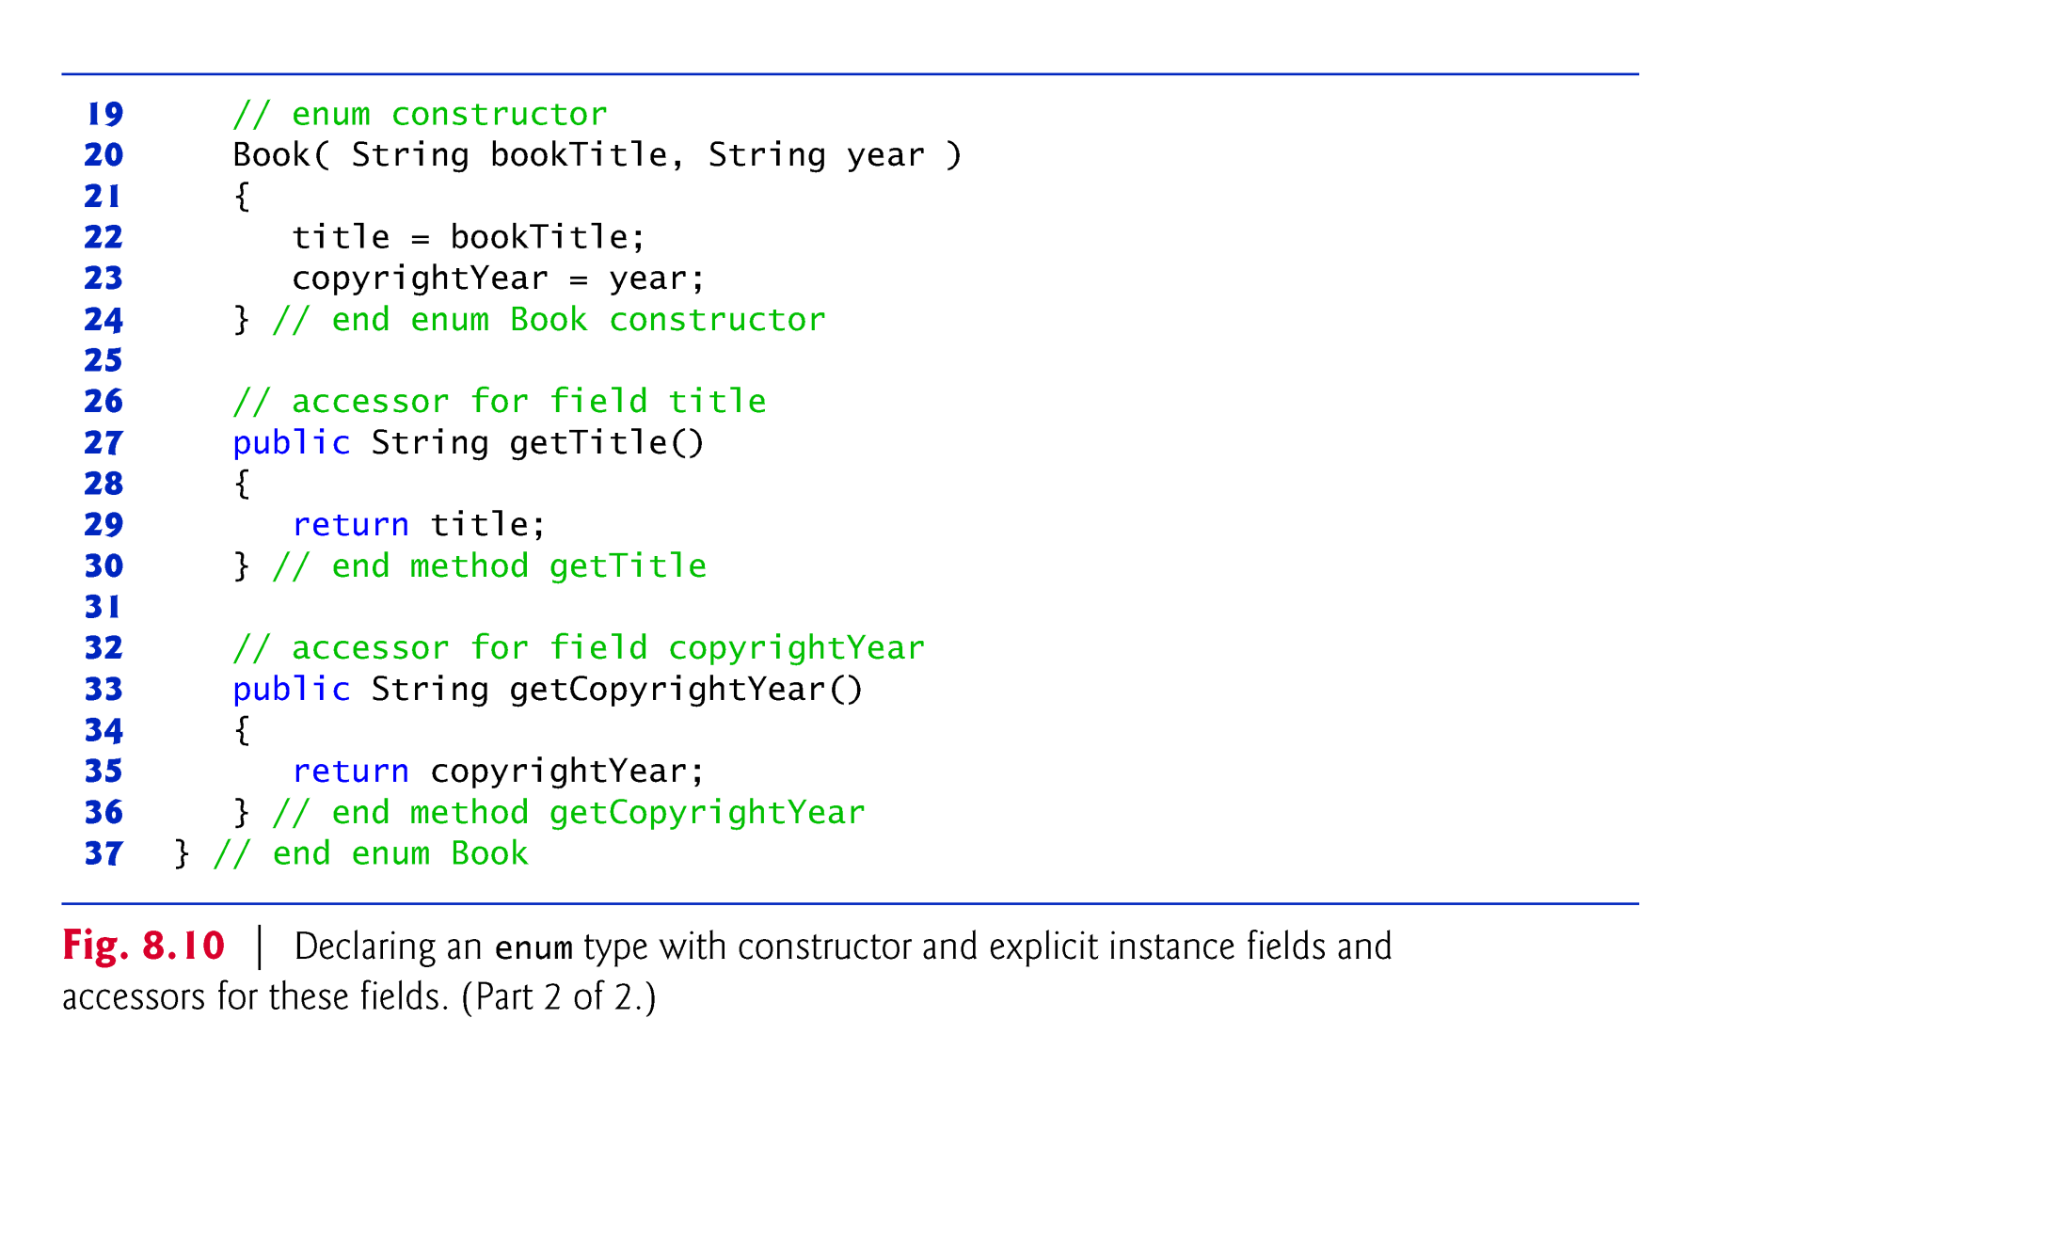

Slide 62
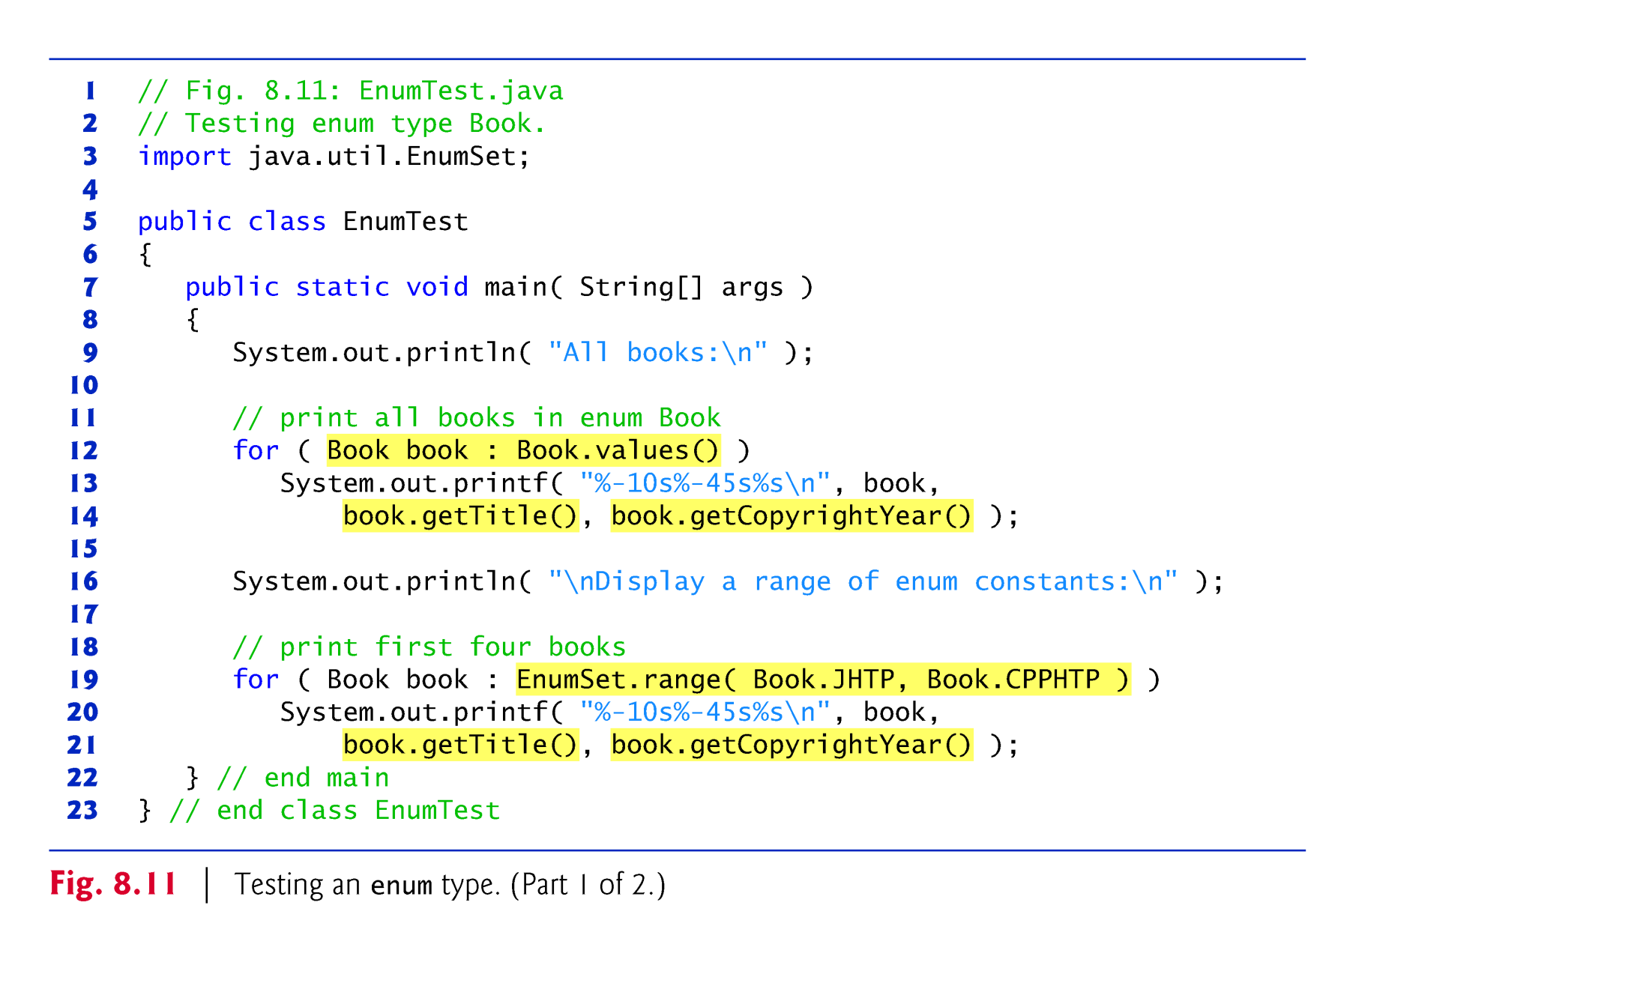

Slide 63
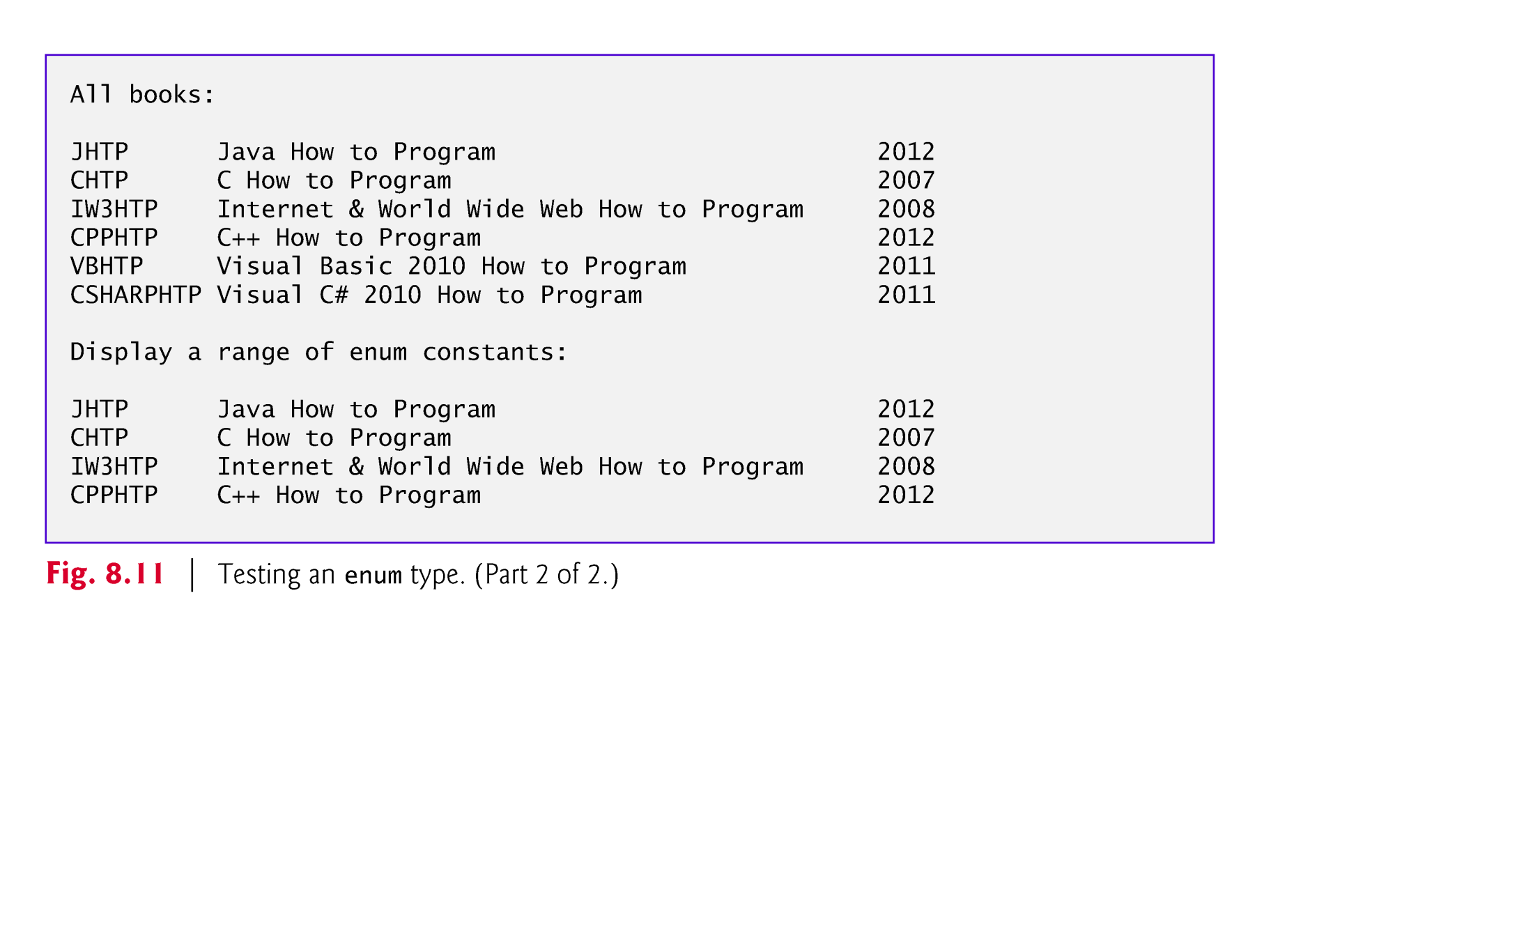

Slide 64
8.9 Enum Type (Cont.)
Use the static method range of class EnumSet (declared in package java.util) to access a range of an enum’s constants.
Method range takes two parameters—the first and the last enum constants in the range
Returns an EnumSet that contains all the constants between these two constants, inclusive.
The enhanced for statement can be used with an EnumSet just as it can with an array.
Class EnumSet provides several other static methods.
https://docs.oracle.com/en/java/javase/13/docs/api/java.base/java/util/EnumSet.html

Slide 65


Slide 66
8.10 Garbage Collection
Every class in Java has the methods of class Object (package java.lang), one of which is the finalize method.
Rarely used because it can cause performance problems and there is some uncertainty as to whether it will get called.
Every object uses system resources, such as memory.
Need a disciplined way to give resources back to the system when they’re no longer needed; otherwise, “resource leaks” might occur.

Slide 67
8.10 Garbage Collection (Cont.)
The JVM performs automatic garbage collection to reclaim the memory occupied by objects that are no longer used.
When there are no more references to an object, the object is eligible to be collected.
This typically occurs when the JVM executes its garbage collector
Other types of resource leaks can occur.
An application may open a file on disk to modify its contents.
If it does not close the file, the application must terminate before any other application can use it.

Slide 68
8.10 Garbage Collection (Cont.)
The finalize method is called by the garbage collector to perform termination housekeeping on an object just before the garbage collector reclaims the object’s memory.
Method finalize does not take parameters and has return type void.
A problem with method finalize is that the garbage collector is not guaranteed to execute at a specified time.
The garbage collector may never execute before a program terminates.
Thus, it’s unclear if, or when, method finalize will be called.
For this reason, most programmers should avoid method finalize.

Slide 69
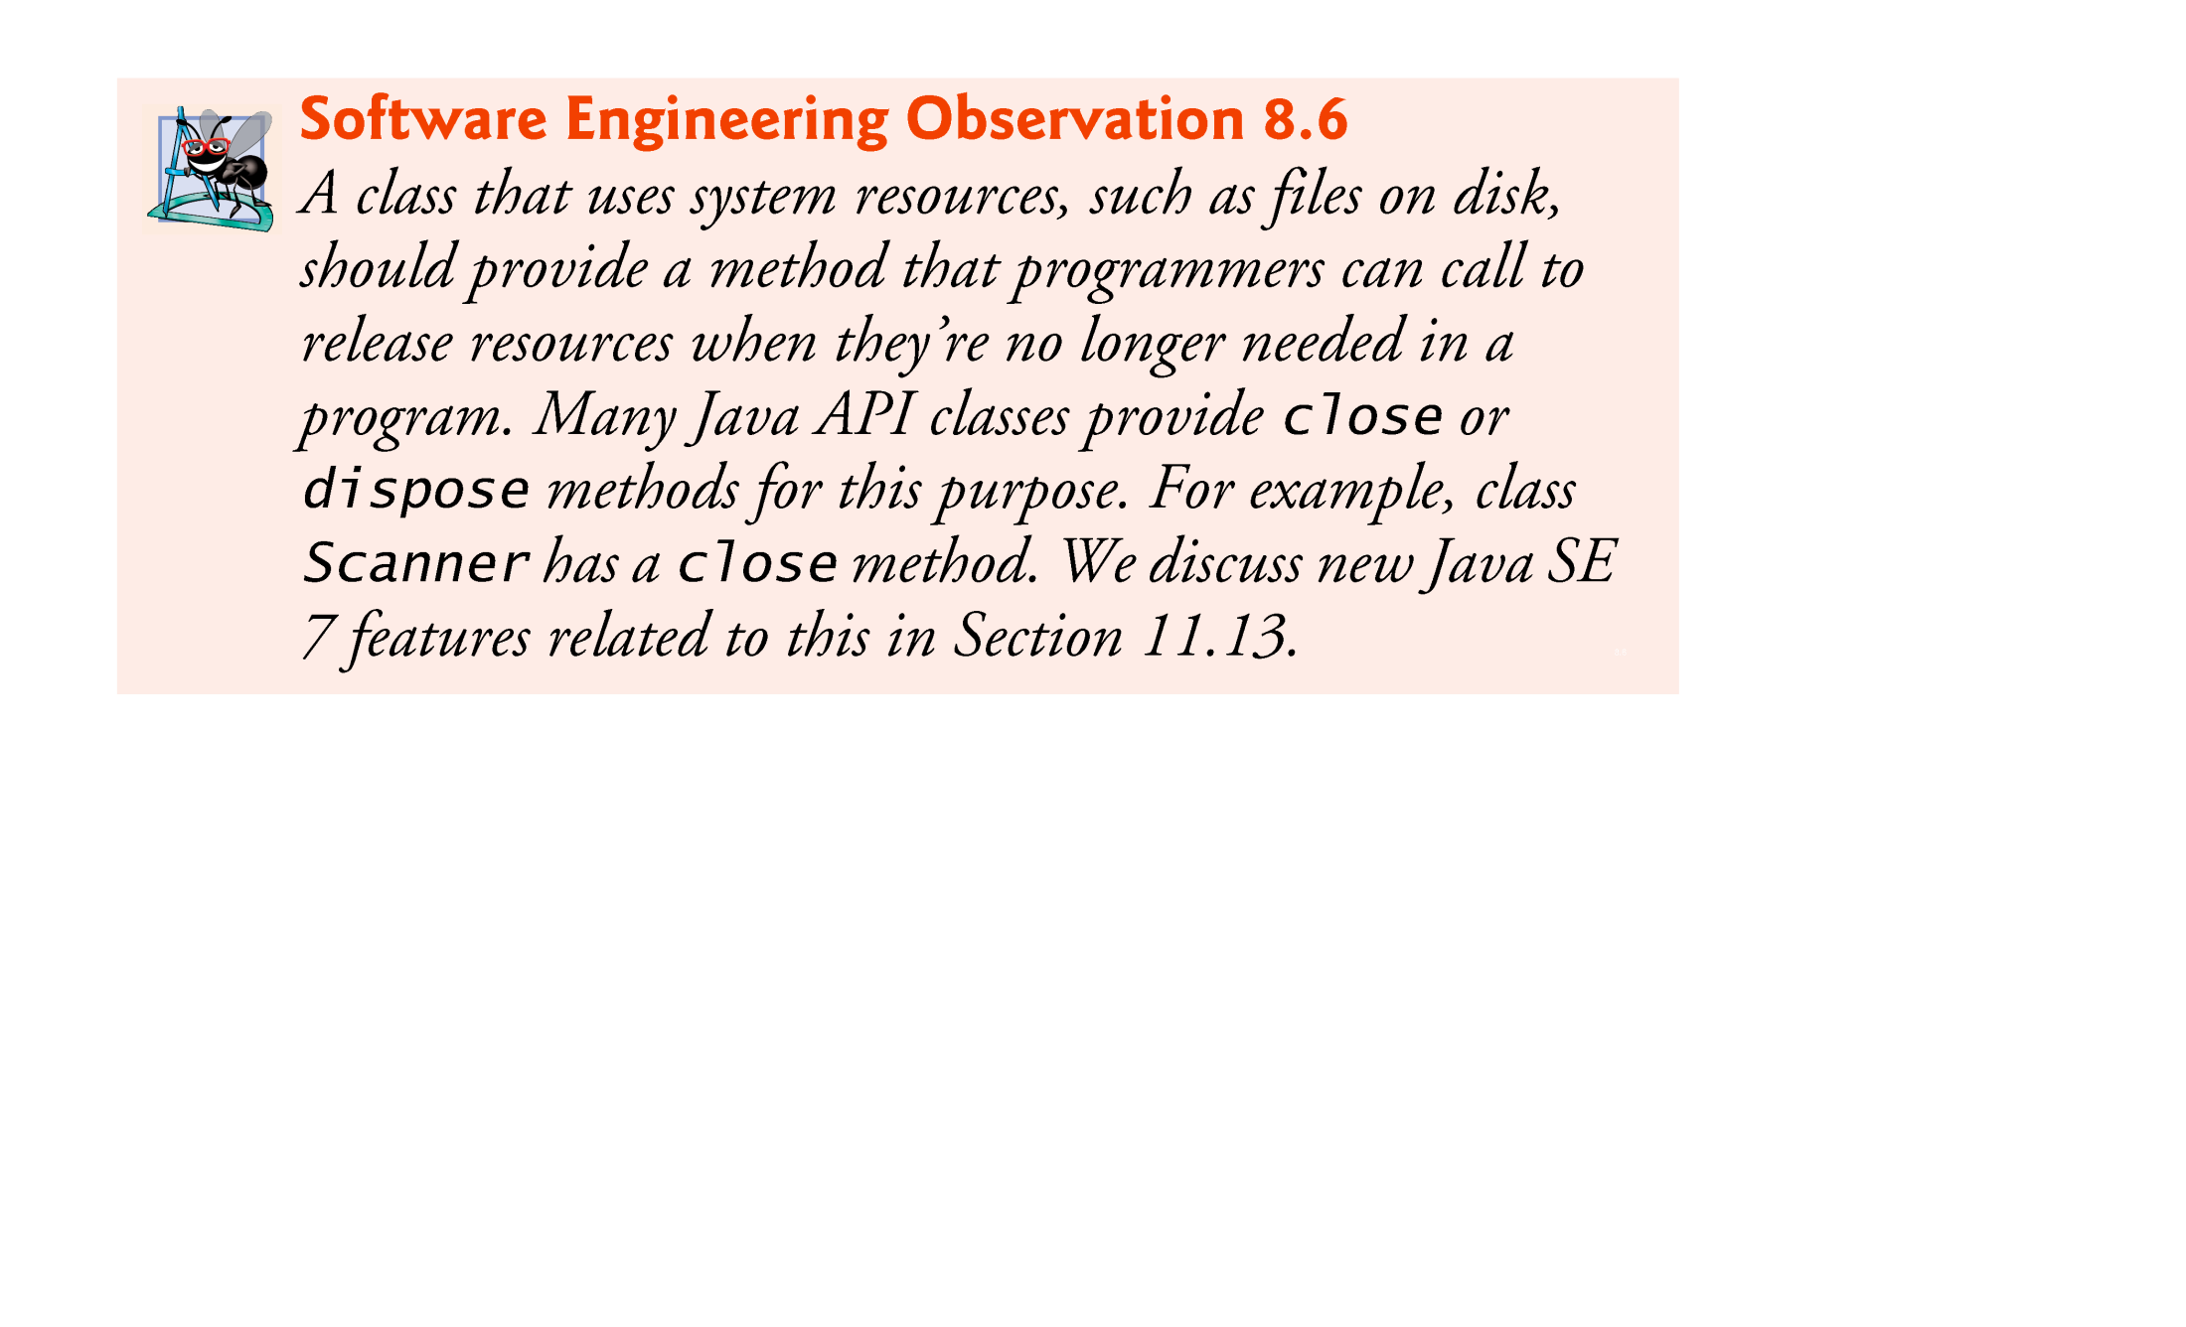

Slide 70
8.11 static Class Members
In certain cases, only one copy of a particular variable should be shared by all objects of a class.
A static field—called a class variable—is used in such cases.
A static variable represents classwide information—all objects of the class share the same piece of data.
The declaration of a static variable begins with the keyword static.

Slide 71
8.11 static Class Members (Cont.)
Static variables have class scope.
Can access a class’s public static members through a reference to any object of the class, or by qualifying the member name with the class name and a dot (.), as in Math.random().
private static class members can be accessed by client code only through methods of the class.

Slide 72
8.11 static Class Members (Cont.)
To access a public static member when no objects of the class exist (and even when they do), prefix the class name and a dot (.) to the static member, as in Math.PI.
To access a private static member when no objects of the class exist, provide a public static method and call it by qualifying its name with the class name and a dot.

Slide 73
8.11 static Class Members (Cont.)
A static method cannot access non-static class members, because a static method can be called even when no objects of the class have been instantiated.
For the same reason, the this reference cannot be used in a static method.
If a static variable is not initialized, the compiler assigns it a default value—in this case 0, the default value for type int.

Slide 74


Slide 75
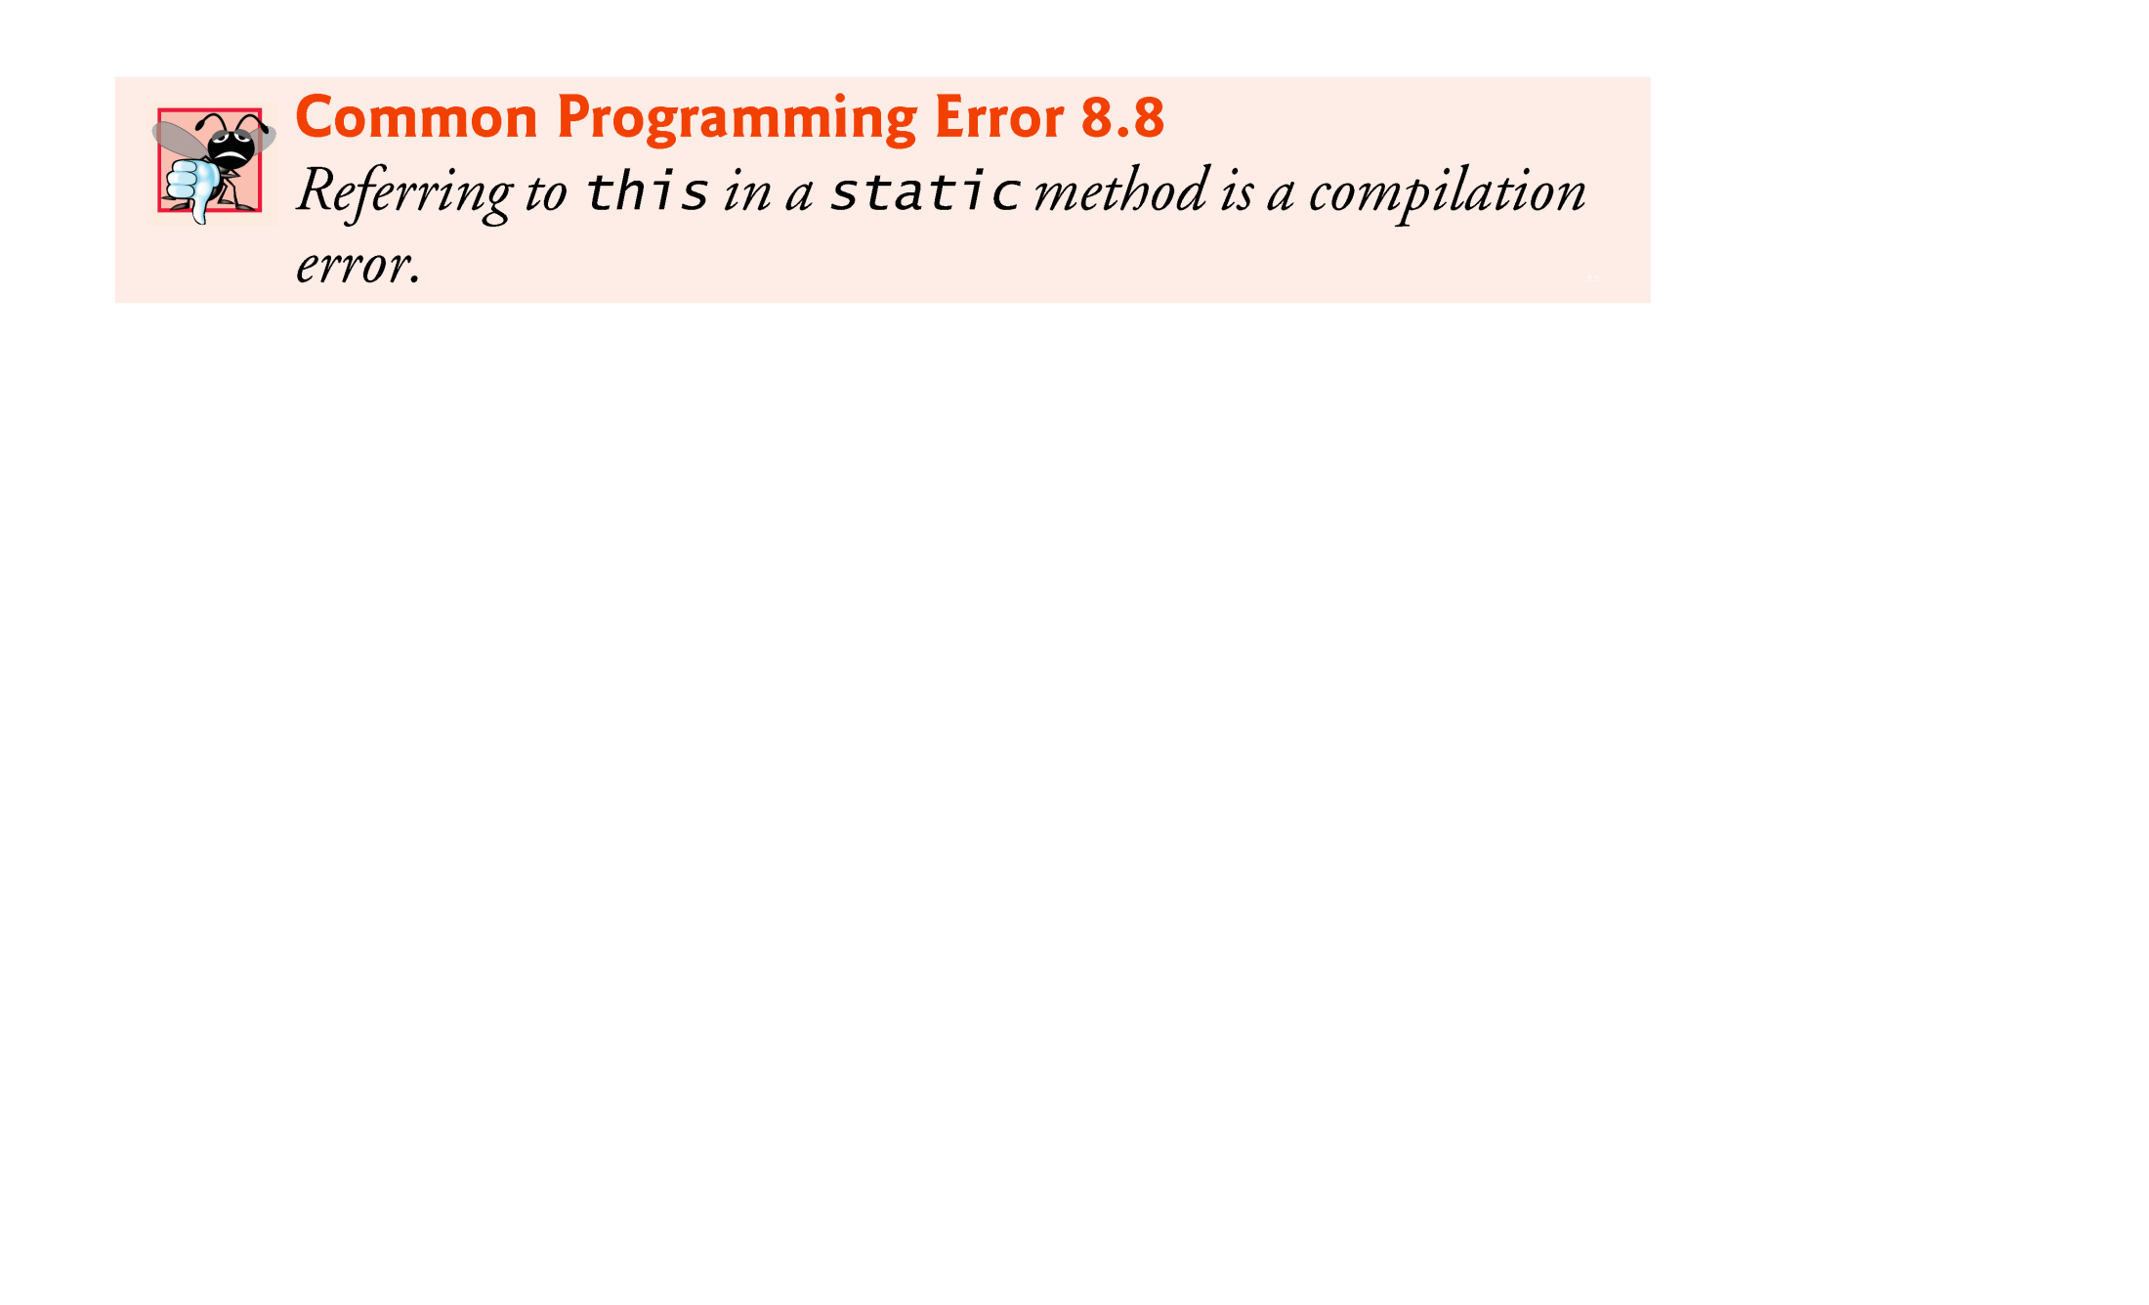

Slide 76
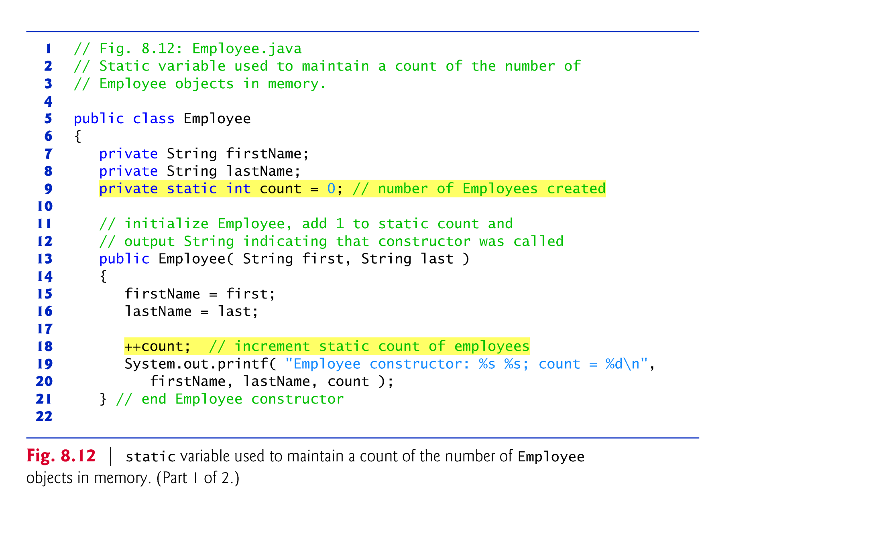

Slide 77
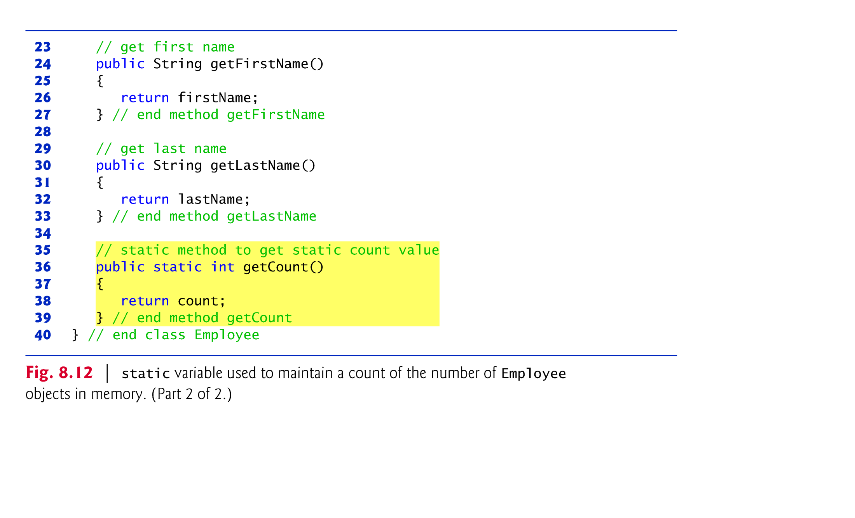

Slide 78


Slide 79
8.11 static Class Members (Cont.)
String objects in Java are immutable—they cannot be modified after they are created.
Therefore, it’s safe to have many references to one String object.
This is not normally the case for objects of most other classes in Java.
? s1 = s1 + “abc”
s1 results in a new String object

Slide 80
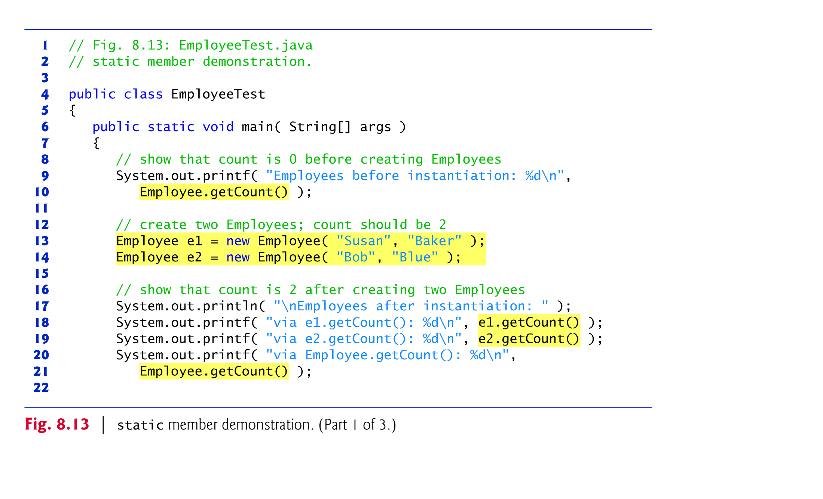

Slide 81
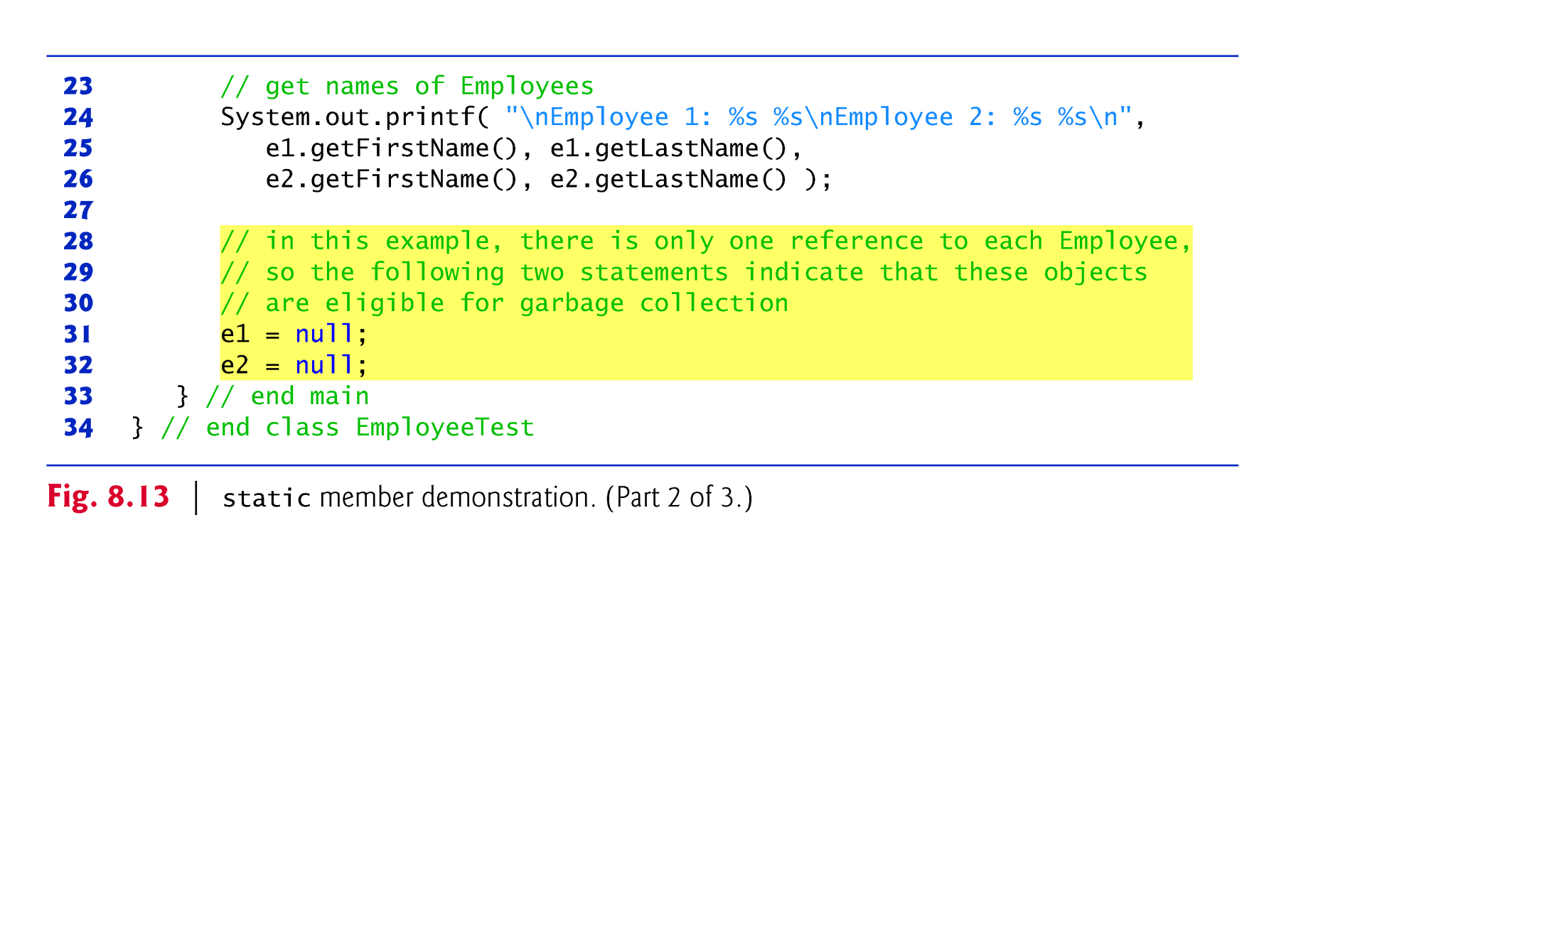

Slide 82
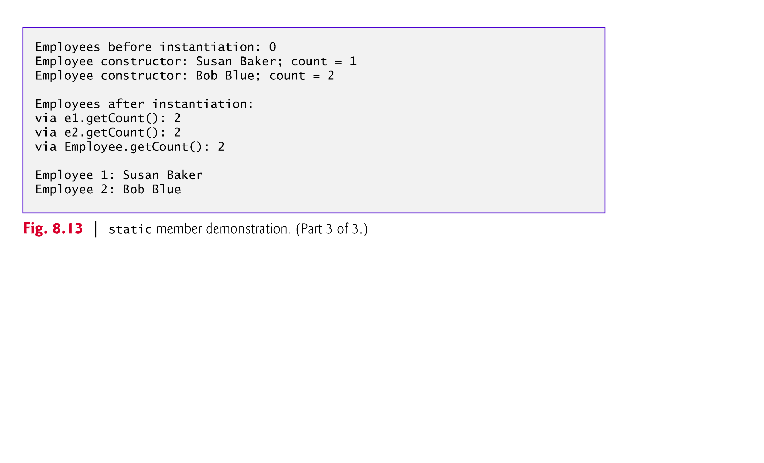

Slide 83
8.11 static Class Members (Cont.)
Objects become “eligible for garbage collection” when there are no more references to them in the program.
The JVM does not guarantee when, or even whether, the garbage collector will execute.
When the garbage collector does execute, it’s possible that no objects or only a subset of the eligible objects will be collected.

Slide 84
8.12 static Import
A static import declaration enables you to import the static members of a class or interface so you can access them via their unqualified names in your class—the class name and a dot (.) are not required to use an imported static member.
Two forms
One that imports a particular static member (which is known as single static import)
One that imports all static members of a class (which is known as static import on demand)

Slide 85
8.12 static Import (Cont.)
The following syntax imports a particular static member:
import static packageName.ClassName.staticMemberName;
The following syntax imports all static members of a class:
import static packageName.ClassName.*;
static import declarations import only static class members.
Regular import statements should be used to specify the classes used in a program.

Slide 86
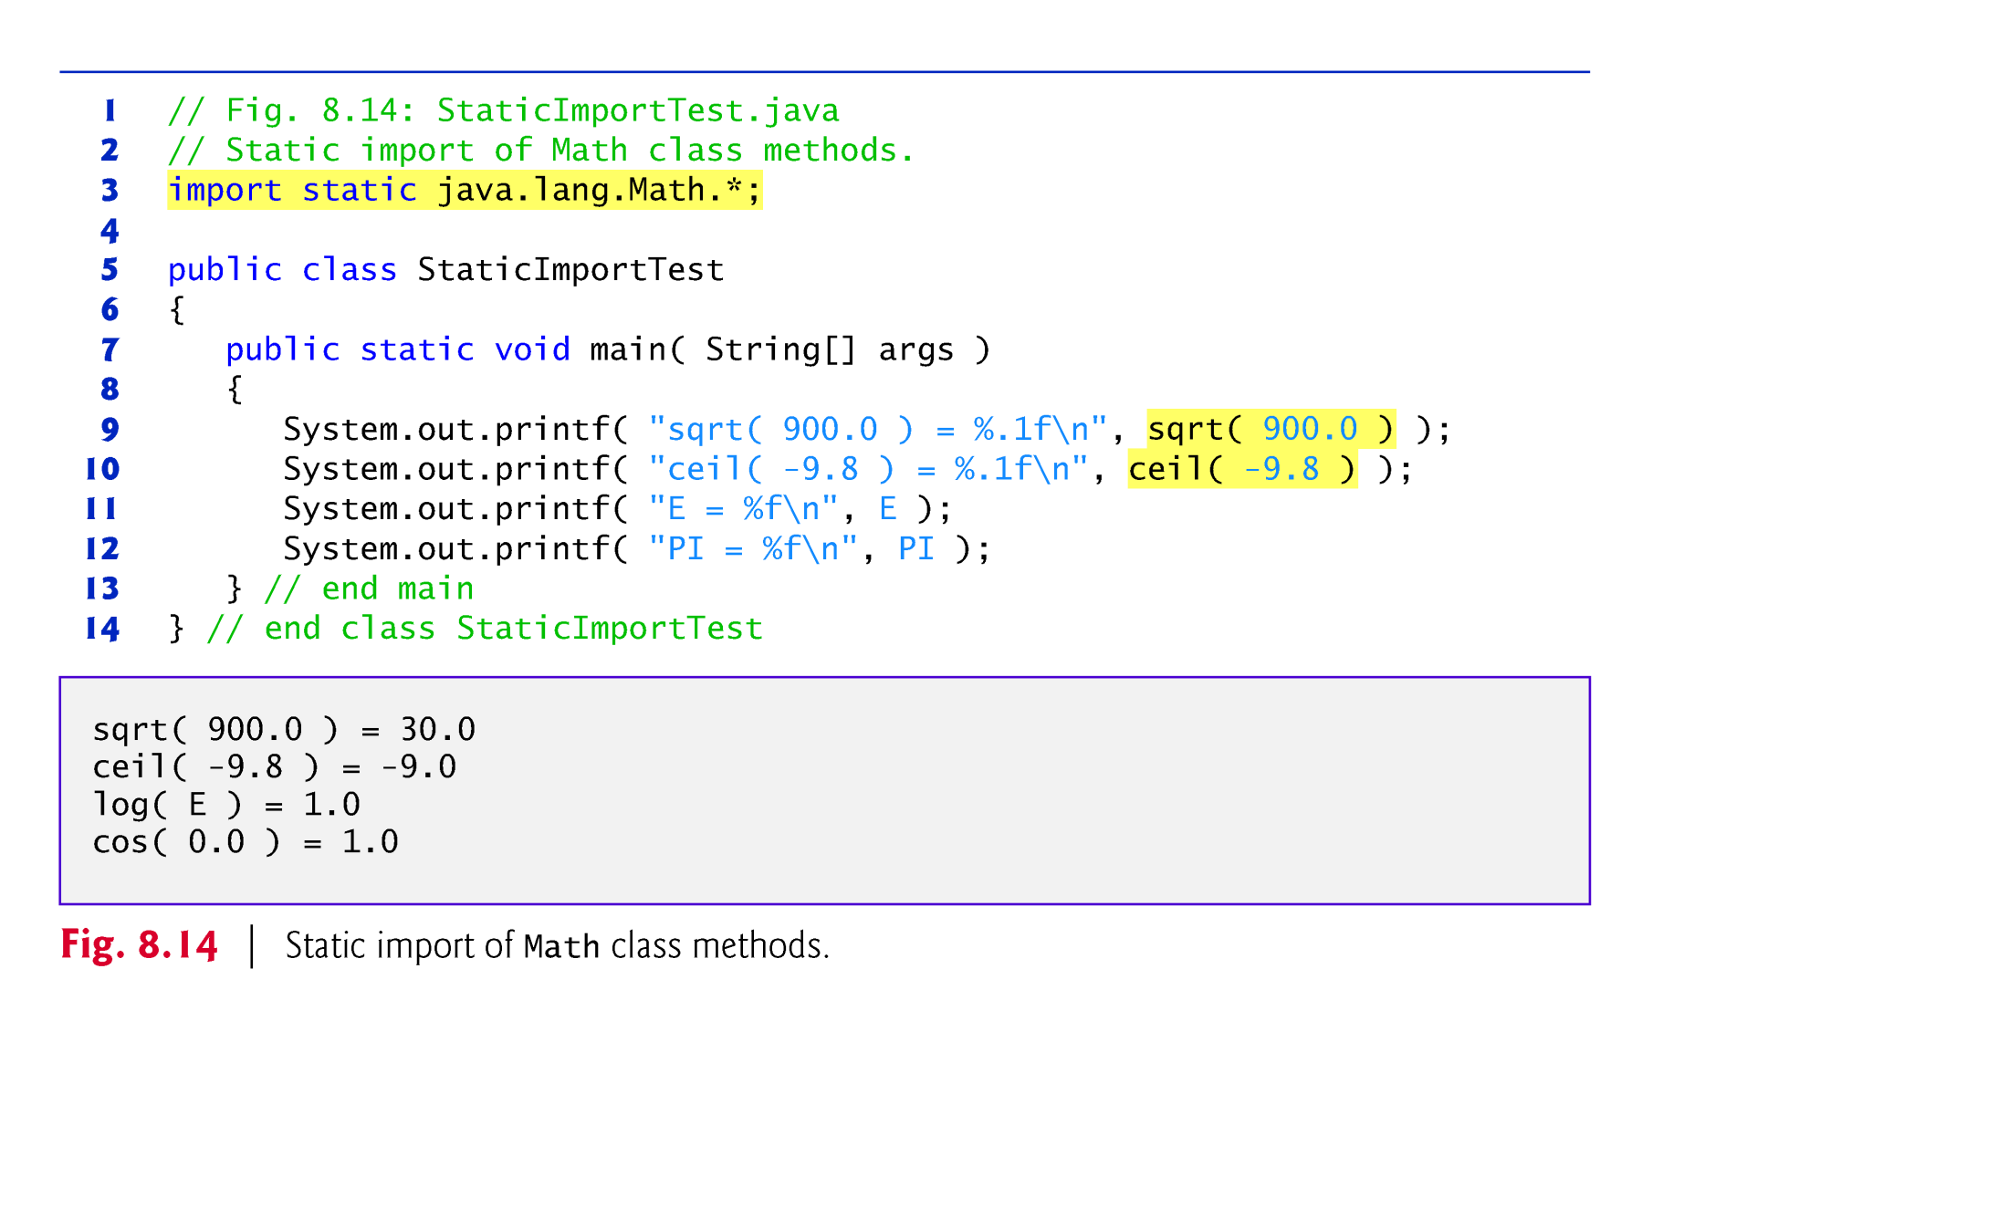

Slide 87


Slide 88
8.13 final Instance Variables
The principle of least privilege is fundamental to good software engineering.
Code should be granted only the amount of privilege and access that it needs to accomplish its designated task, but no more.
Makes your programs more robust by preventing code from accidentally (or maliciously) modifying variable values and calling methods that should not be accessible.
Keyword final specifies that a variable is not modifiable (i.e., it’s a constant) and any attempt to modify it is an error.
private final int INCREMENT;
Declares a final (constant) instance variable INCREMENT of type int.

Slide 89
8.13 final Instance Variables (cont.)
final variables can be initialized when they are declared or by each of the class’s constructors so that each object of the class has a different value.
If a class provides multiple constructors, every one would be required to initialize each final variable.
A final variable cannot be modified by assignment after it’s initialized.
If a final variable is not initialized, a compilation error occurs.

Slide 90


Slide 91


Slide 92
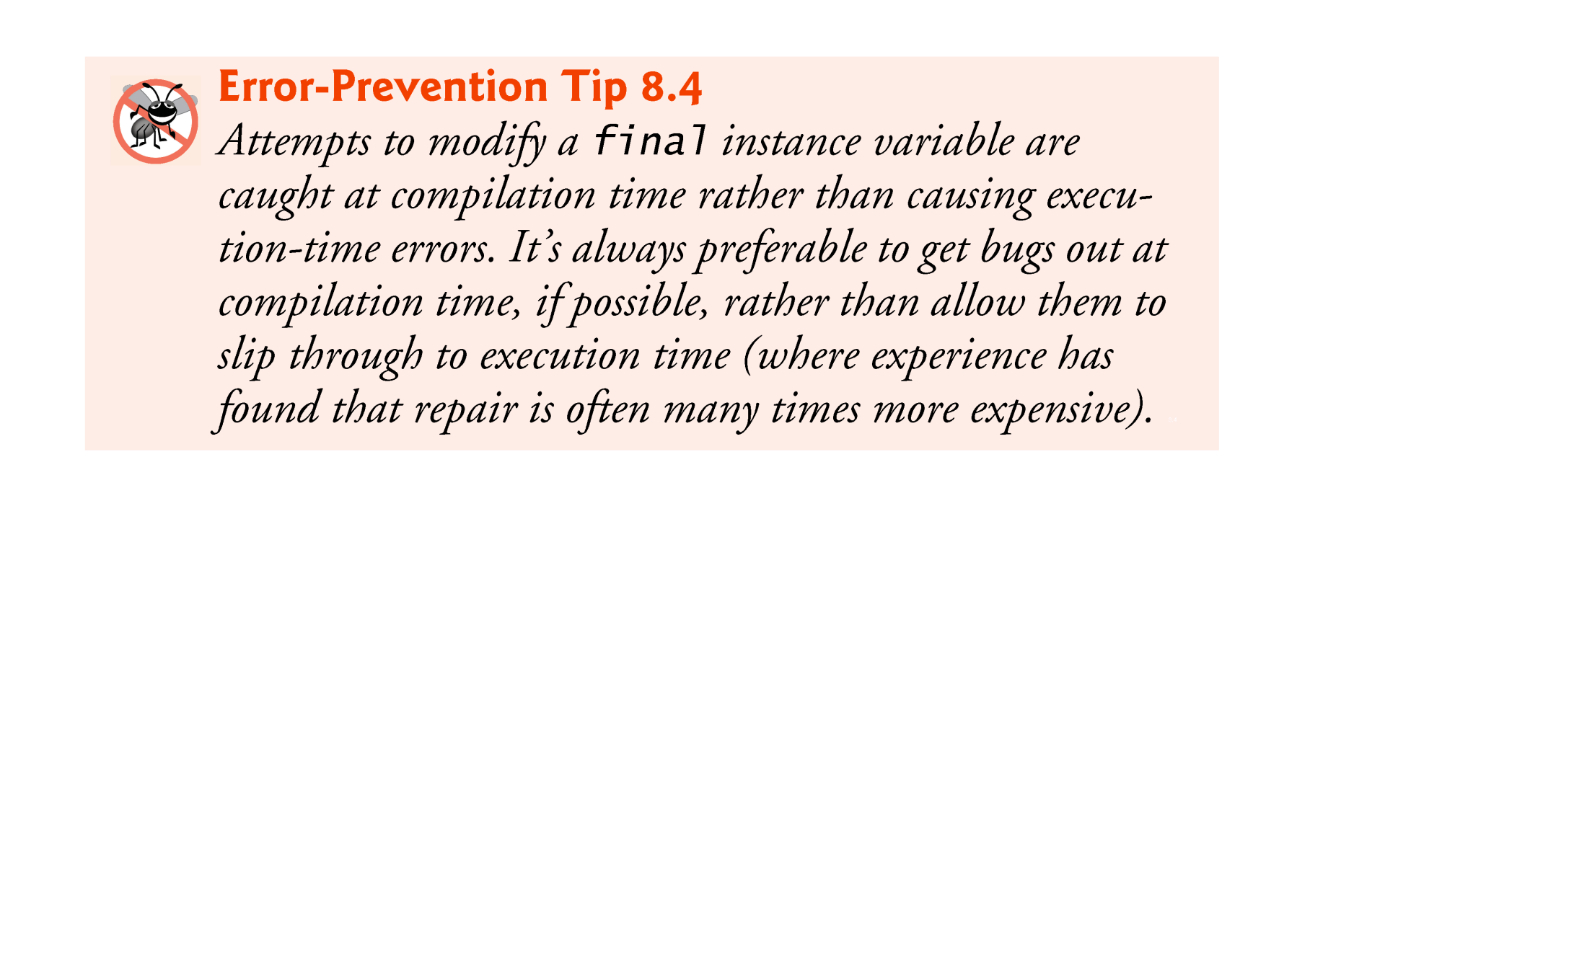

Slide 93


Slide 94
8.14 Time Class Case Study: Creating Packages
Each class in the Java API belongs to a package that contains a group of related classes.
Packages are defined once, but can be imported into many programs.
Packages help programmers manage the complexity of application components.
Packages facilitate software reuse by enabling programs to import classes from other packages, rather than copying the classes into each program that uses them.
Packages provide a convention for unique class names, which helps prevent class-name conflicts.

Slide 95
8.14 Time Class Case Study: Creating Packages (Cont.)
The steps for creating a reusable class:
Declare a public class; otherwise, it can be used only by other classes in the same package.
Choose a unique package name and add a package declaration to the source-code file for the reusable class declaration.
In each Java source-code file there can be only one package declaration, and it must precede all other declarations and statements.
Compile the class so that it’s placed in the appropriate package directory.
Import the reusable class into a program and use the class.

Slide 96
8.15 Time Class Case Study: Creating Packages (Cont.)
A Java source-code file must have the following order:
a package declaration (if any),
import declarations (if any), then
class declarations.

Slide 97


Slide 98


Slide 99
8.14 Time Class Case Study: Creating Packages (Cont.)
Every package name should start with your Internet domain name in reverse order.
For example, our domain name is deitel.com, so our package names begin with com.deitel.
For the domain name yourcollege.edu, the package name should begin with edu.yourcollege.
After the domain name is reversed, you can choose any other names you want for your package.
We chose to use jhtp as the next name in our package name to indicate that this class is from Java How to Program.
The last name in our package name specifies that this package is for Chapter 8 (ch08).

Slide 100
8.14 Time Class Case Study: Creating Packages (Cont.)
Compile the class so that it’s stored in the appropriate package.
When a Java file containing a package declaration is compiled, the resulting class file is placed in the directory specified by the declaration.
The package declaration
package com.deitel.jhtp.ch08;
indicates that class Time1 should be placed in the directory
com deitel jhtp ch08
The directory names in the package declaration specify the exact location of the classes in the package.

Slide 101
8.14 Time Class Case Study: Creating Packages (Cont.)
javac command-line option -d causes the javac compiler to create appropriate directories based on the class’s package declaration.
The option also specifies where the directories should be stored.
Example:
javac -d . Time1.java
specifies that the first directory in our package name should be placed in the current directory (.).
The compiled classes are placed into the directory that is named last in the package statement.

Slide 102
8.14 Time Class Case Study: Creating Packages (Cont.)
The package name is part of the fully qualified class name.
Class Time1’s name is actually com.deitel.jhtp.ch08.Time1
Can use the fully qualified name in programs, or import the class and use its simple name (the class name by itself).
If another package contains a class by the same name, the fully qualified class names can be used to distinguish between the classes in the program and prevent a name conflict (also called a name collision).

Slide 103
8.14 Time Class Case Study: Creating Packages (Cont.)
Fig. 8.15, line 3 is a single-type-import declaration
It specifies one class to import.
When your program uses multiple classes from the same package, you can import those classes with a type-import-on-demand declaration.
Example:
import java.util.*; // import java.util classes
uses an asterisk (*) at the end of the import declaration to inform the compiler that all public classes from the java.util package are available for use in the program.
Only the classes from package java-.util that are used in the program are loaded by the JVM.

Slide 104


Slide 105


Slide 106


Slide 107


Slide 108
8.14 Time Class Case Study: Creating Packages (Cont.)
Specifying the Classpath During Compilation
When compiling a class that uses classes from other packages, javac must locate the .class files for all other classes being used.
The compiler uses a special object called a class loader to locate the classes it needs.
The class loader begins by searching the standard Java classes that are bundled with the JDK.
Then it searches for optional packages.
If the class is not found in the standard Java classes or in the extension classes, the class loader searches the classpath, which contains a list of locations in which classes are stored.

Slide 109
8.14 Time Class Case Study: Creating Packages (Cont.)
The classpath consists of a list of directories or archive files, each separated by a directory separator
Semicolon (;) on Windows or a colon (:) on UNIX/Linux/Mac OS X.
Archive files are individual files that contain directories of other files, typically in a compressed format.
Archive files normally end with the .jar or .zip file-name extensions.
The directories and archive files specified in the classpath contain the classes you wish to make available to the Java compiler and the JVM.

Slide 110
8.14 Time Class Case Study: Creating Packages (Cont.)
By default, the classpath consists only of the current directory.
The classpath can be modified by
providing the -classpath option to the javac compiler
setting the CLASSPATH environment variable (not recommended).
Classpath
download.oracle.com/javase/6/docs/technotes/tools/index.html#genera
The section entitled “General Information” contains information on setting the classpath for UNIX/Linux and Windows.

Slide 111
8.15 Package Access
If no access modifier is specified for a method or variable when it’s declared in a class, the method or variable is considered to have package access.
Package access is rarely used.

Slide 112


Slide 113


Slide 114


Slide 115
8.16 Jar File
jar
Java archive utility
JAR file is a file format based on the popular ZIP file format and is used for aggregating many files into one.
Bundles classes and packages
Classes and packages are downloaded as one unit (JAR file)
Client makes only one call to server

Slide 116
jar -cf test.jar TimeTest1.class com\*.*
to create the JAR file
jar is the java archive utility used to create JAR files
the letter c indicates that we are creating a JAR files
the letter f indicates that the next argument in the command line is the name of the JAR file to create
test.jar is the name of the JAR file to create
TimeTest1.class com\*.* actual files that will be included in the JAR file
com\*.* call the class in the com directory should be included in the JAR file
note : You can include selected files by specifying the path and file name for each individual file

Slide 117

jar -tvf test.jar
Produce the listing in the fig below.
the letter t indicates that the table of contents for the JAR should be listed.
the letter v indicates that the output should be verbose( the verbose output includes the file size in bytes and the date and time each file was created, in addition to the directory structure and file name)
the letter f specifies that the next argument on the command line is the JAR file to use.

Slide 118
How to make a JAVA application - executable JAR archive (1)
create this manifest file (manifest.mf) with any text editor.
Manifest-Version: 1.0
Main-Class: TimeTest1
include the manifest file in the JAR (TimeTest1.jar) with the TimeTest1 class
jar cvfm test.jar manifest.mf *.class com\*.*
MAC:jar -cfmv test.jar manifest.mf ./
D:\java\07-08第二学期\examples\ch08\jartest2

Slide 119
Then you are able to start the TimeTest1.class by double-clicking on the TimeTest1.jar file (if the JRE is correctly installed) or by typing
java -jar test.jar
If you need to pass parameters, use the -D switch before de -jar switch and use the getProperty() method to get the value.
JarParTest.java
>java –D a=4 -jar test1.jar

Slide 120
How to make a JAVA application - executable JAR archive(2)
Another method:
Create the jar file
jar cf test.jar *.class
Extract the jar file,and modify the file “MANIFEST.MF”,and add the sentence:
Main-Class: Time1
compress volume file again(zip format)

Slide 121
How to make a JAVA application - executable JAR archive
Through program:
Package java.uil.jar
Reference to : http://study.pay500.com/6/s61001.htm

Slide 122
How to make a JAVA application - executable JAR archive(3)
In eclipse:
File->Export…
select Java/Jar File next
select the resource to export and the export destination
next…
Generate the manifest file and select the class of the application entry point

Slide 123


Slide 124

8.17 (Optional) GUI and Graphics Case Study: Using Objects with Graphics

Slide 125


Slide 126


